Slide 1
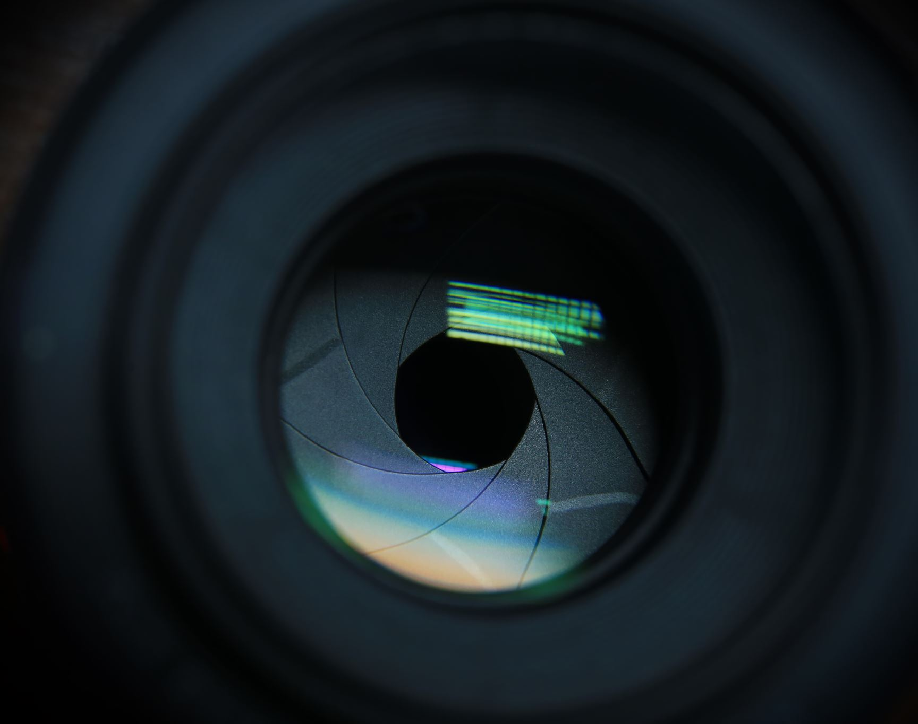
Image Classification with Coded Aperture
Overview, experiment results, and more

Slide 2

Experiments
Classify original MNIST images
1
Classify encoded MNIST images
2
Reconstruct encoded MNIST images, then classify from reconstructions
3
CNN with Sigmoid activation
CNN with NO activation

Slide 3
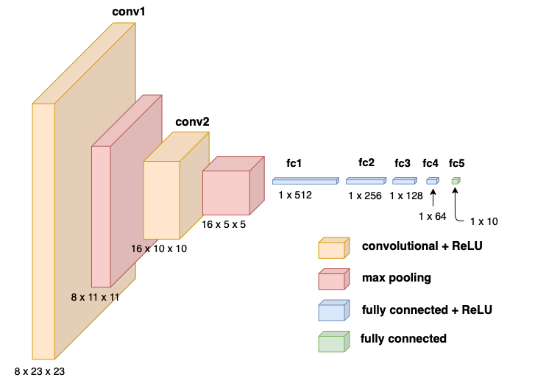
Classification Architecture
2 convolutional layers
2 max pooling layers
4 fully connected layers with ReLu activation
1 output layer

Slide 4
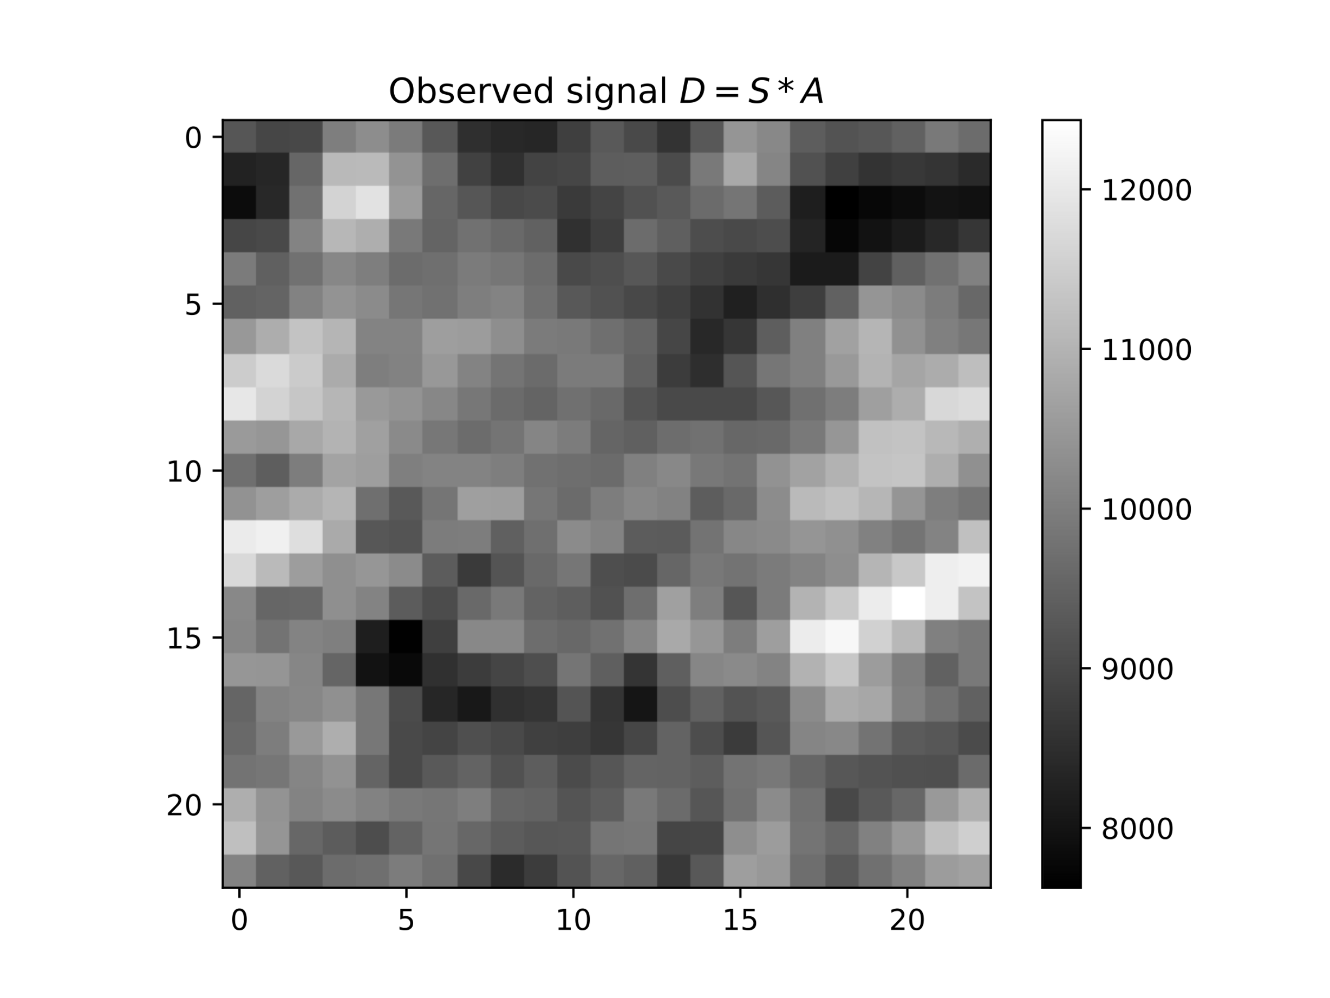
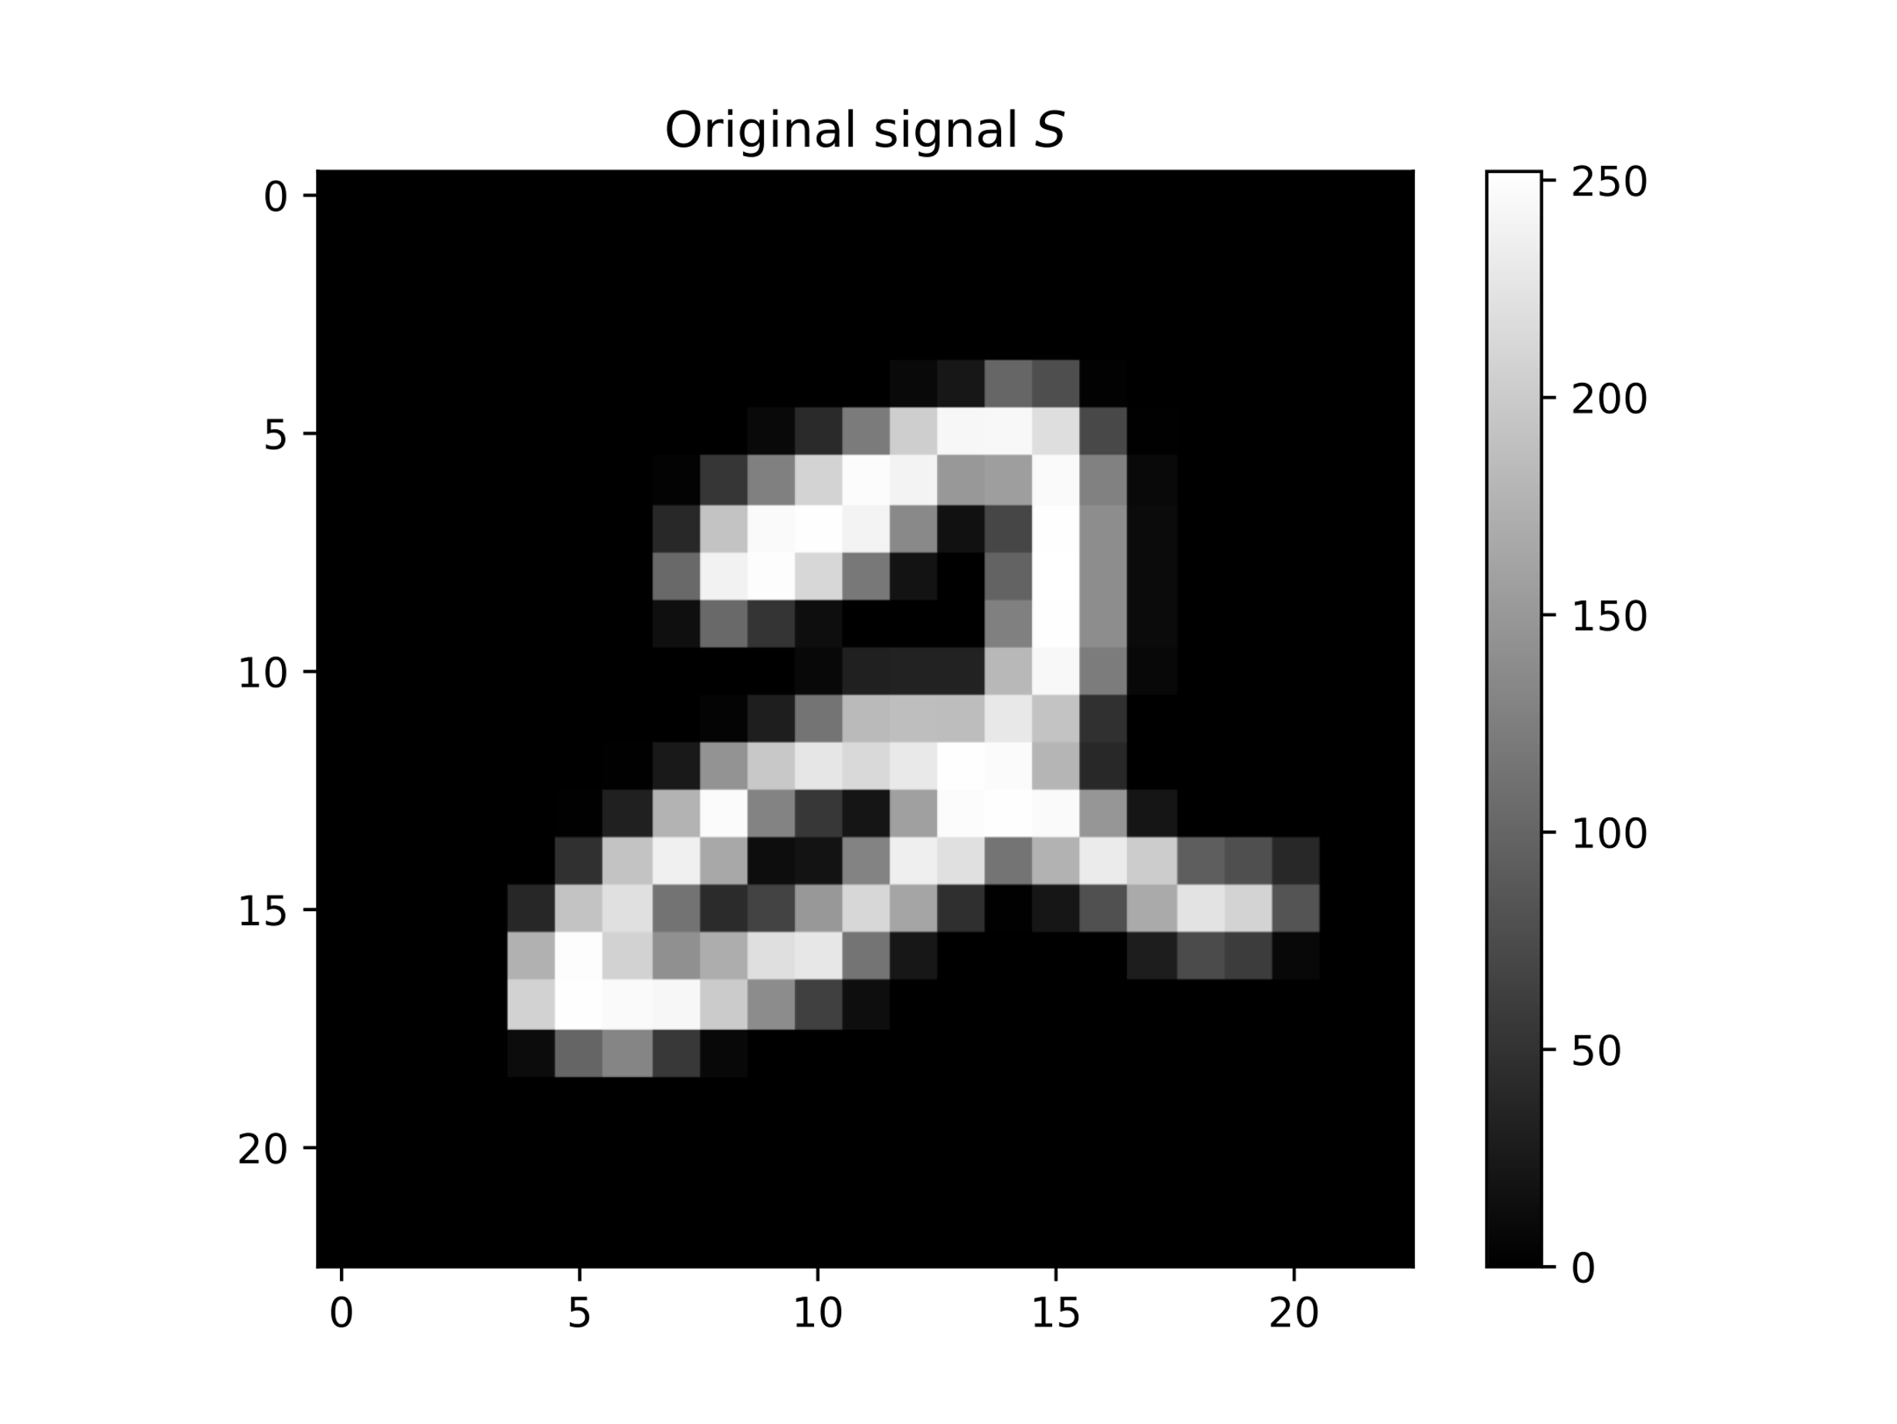
Reconstruction Architecture
The CNN consists of one convolutional layer
kernel = 23
Padding = 11
1 x 23 x 23
1 x 23 x 23
1 x 23 x 23
Convolution

Slide 5
Getting a baseline (target) for the model
Classification accuracy: 98.99% (of 10,000 test images)
The top misclassified digits: 9,4,6,7
9 – misclassified as 4,5,7,8
4 – misclassified as 9,6,2
6 – misclassified as 0,1,3,4,5,8
7 – misclassified as 1,2,4,5,9
1
Classify original MNIST images

Slide 6
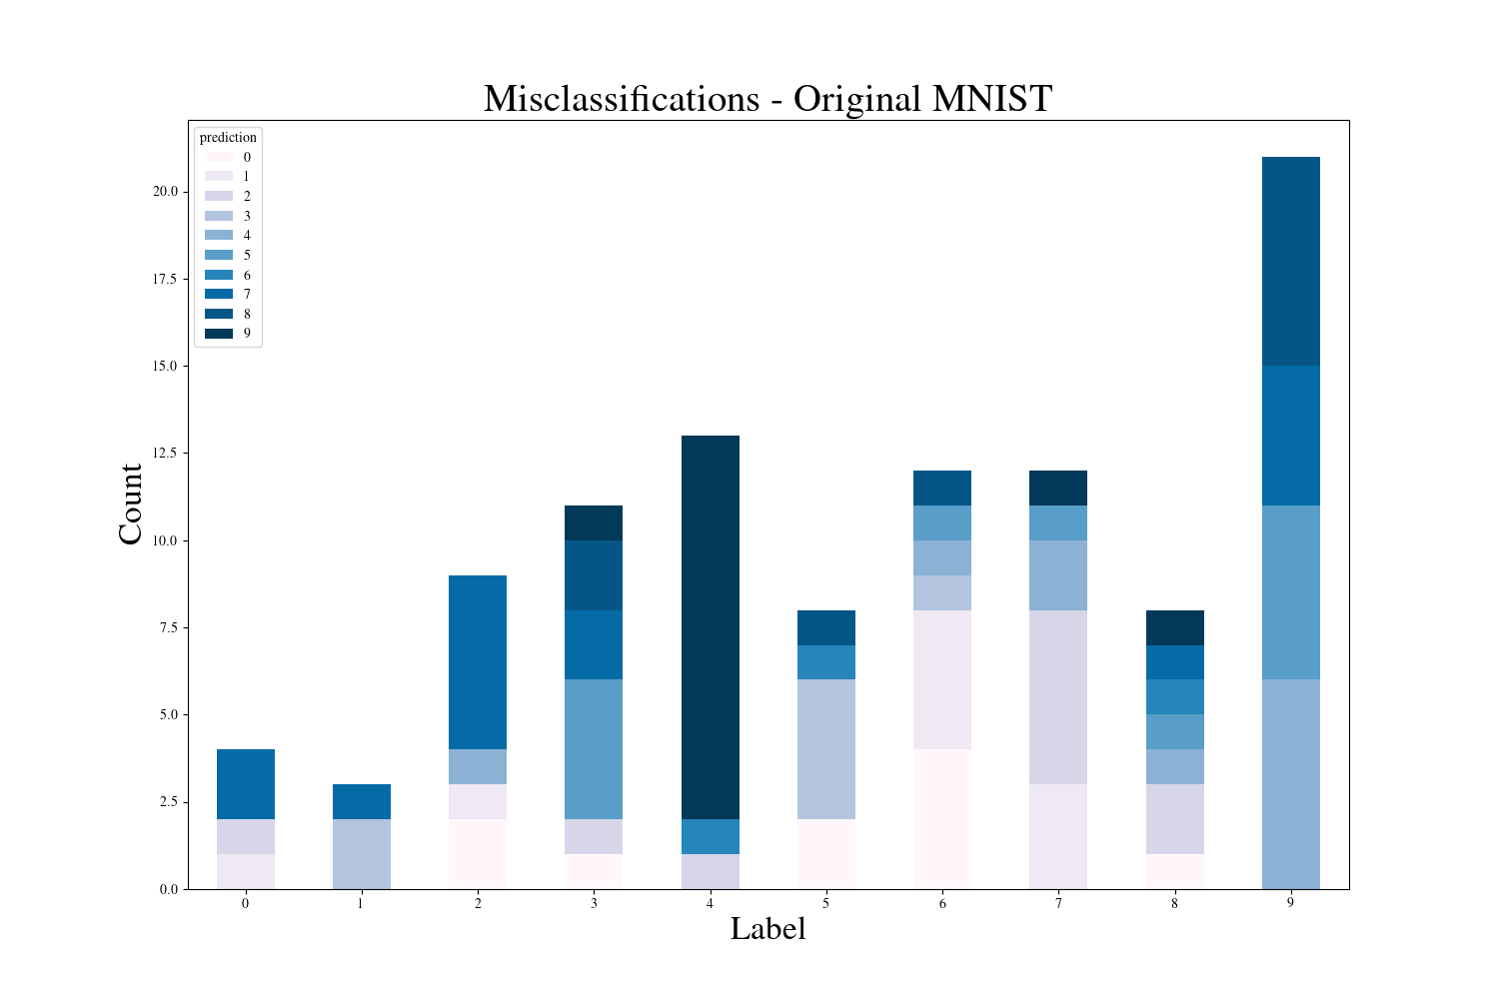

Slide 7
Classifying encoded images doesn’t do too bad
Classification accuracy: 95.35% (10,000 test images)
The top misclassified digits are: 5,7,3,8,9
5 – misclassified as 0, 8, 9, 3, 6, 4, 2
7 – misclassified as 9, 2, 4, 3, 0, 8
3 – misclassified as 8, 7, 5, 9, 2, 1, 0
8 – misclassified as 0, 6, 4, 2, 9, 5, 3, 7
9 – misclassified as 8, 3, 0, 4, 5, 7, 6, 1, 2
2
Classify encoded MNIST images

Slide 8
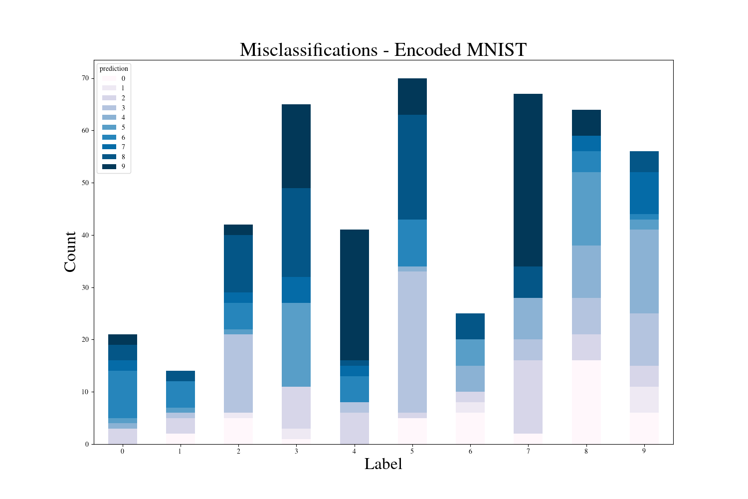

Slide 9
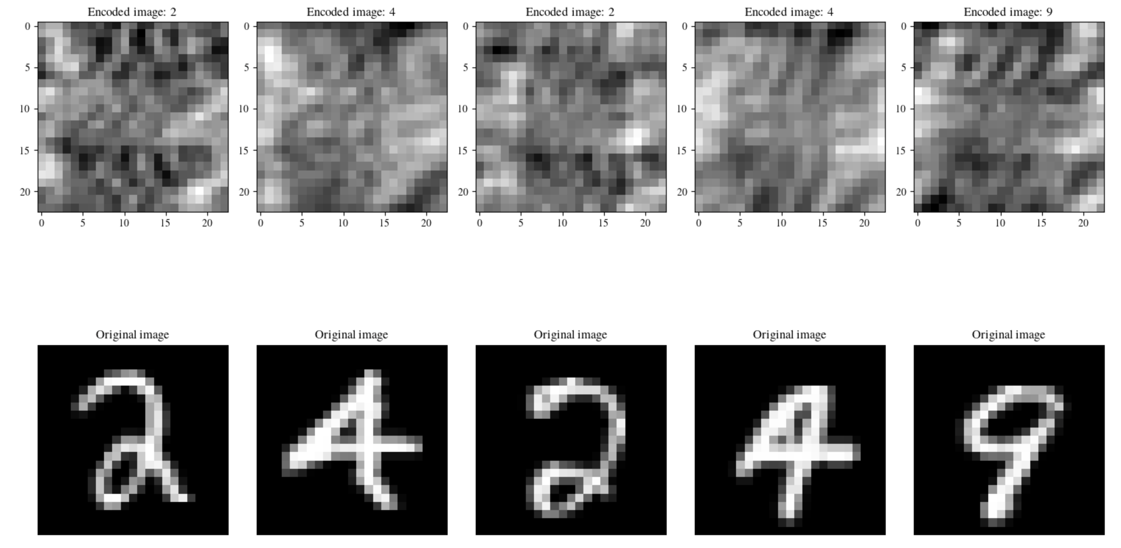
What if we try to reconstruct first?
Input
3
Reconstruct encoded MNIST images, then classify from reconstructions
CNN with Sigmoid activation
CNN with NO activation
Target

Slide 10
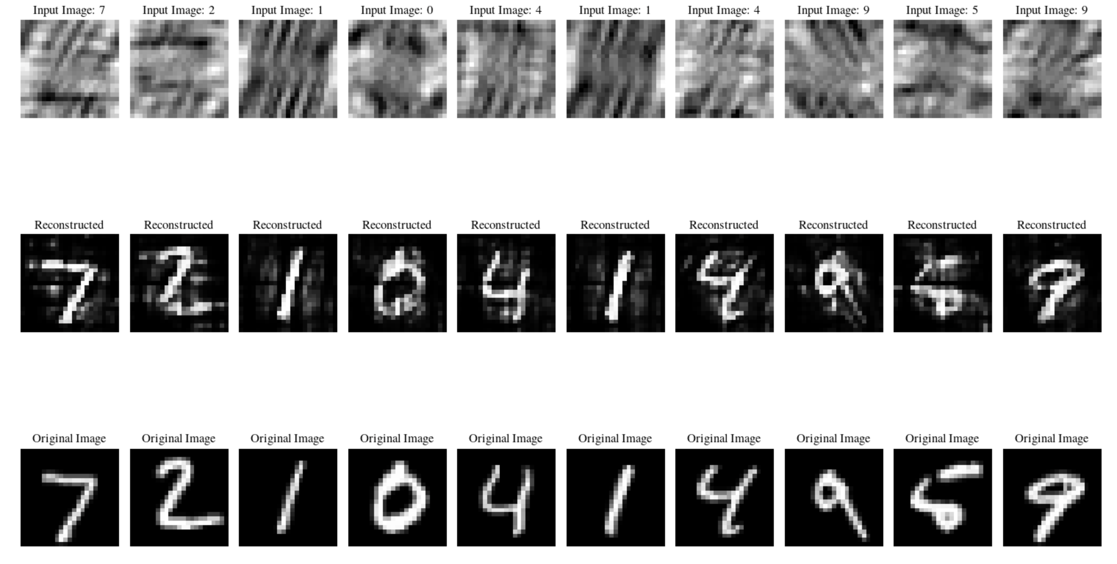
Reconstructions using Sigmoid Activation

Slide 11
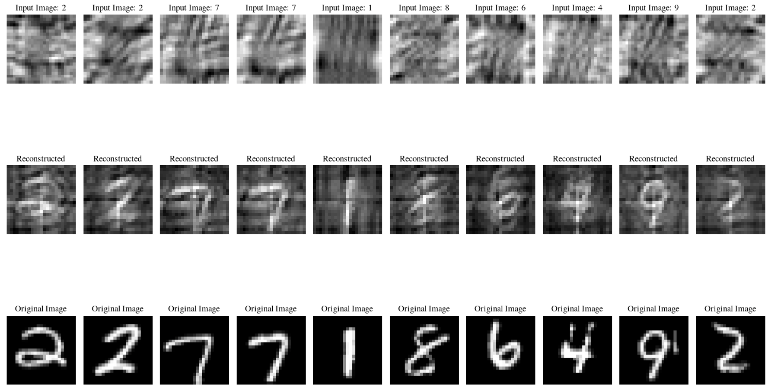
Reconstructions using NO Activation

Slide 12
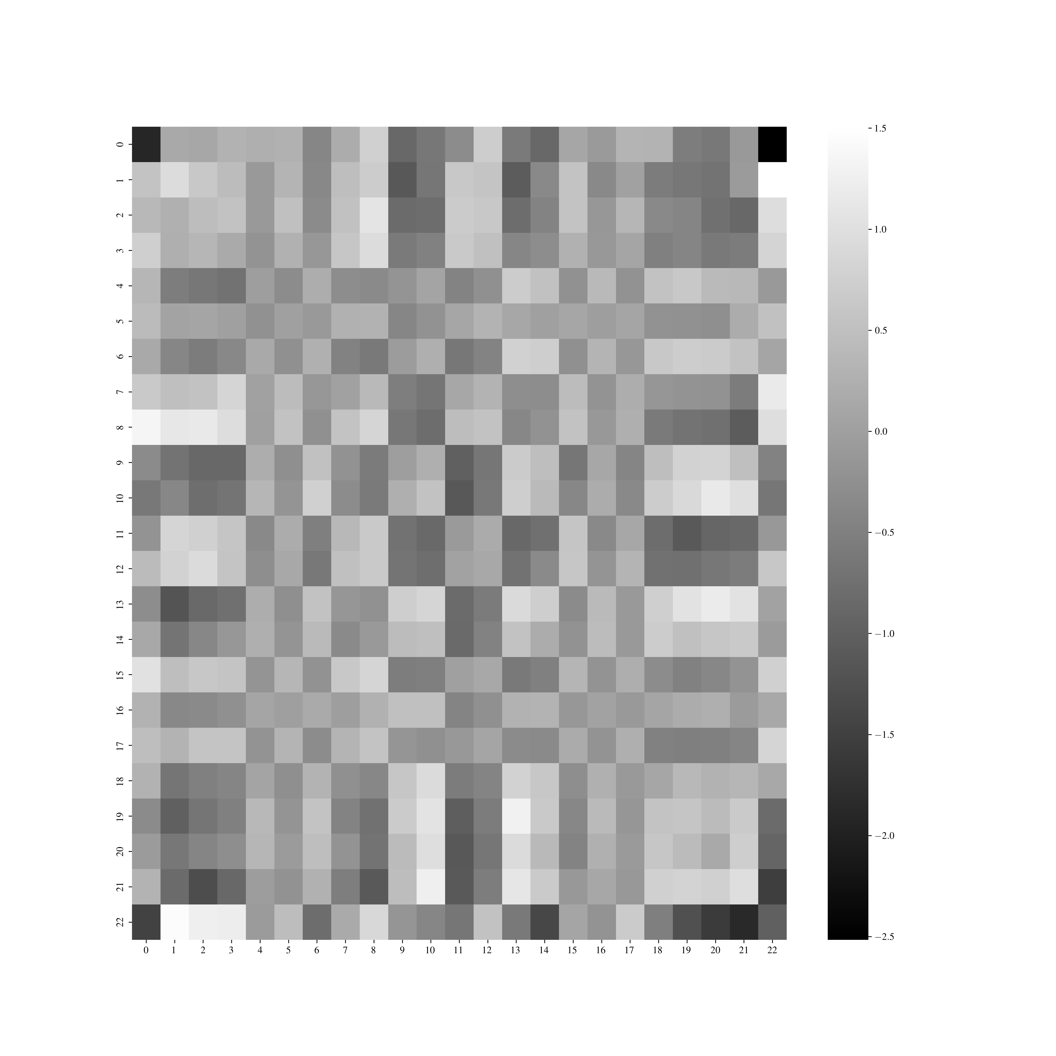
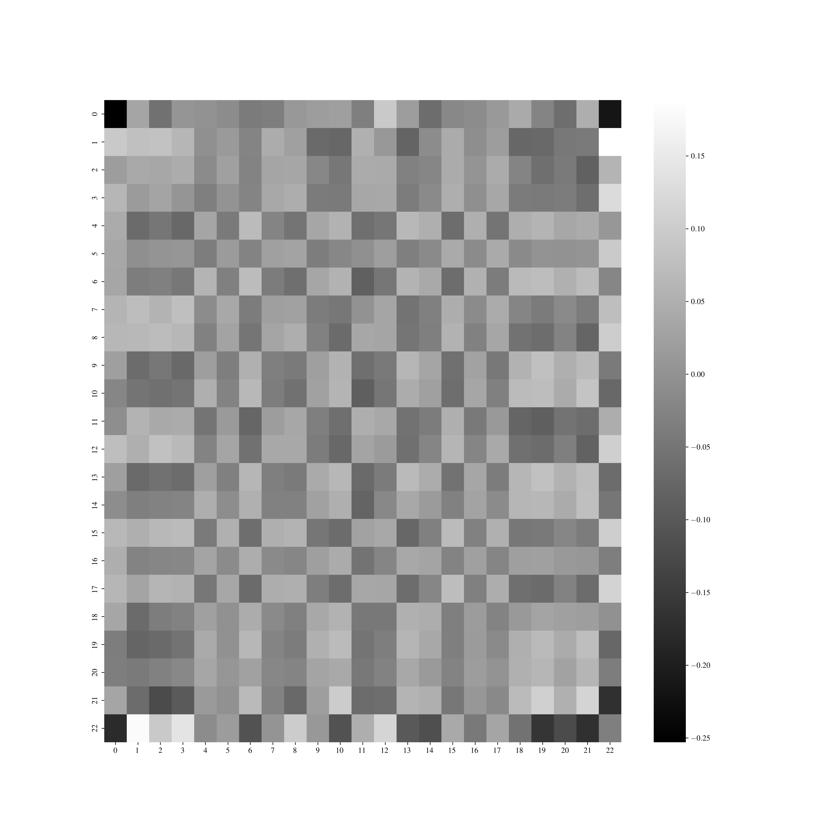
How do the weights differ?
Sigmoid activation
NO activation

Slide 13
Limit colorbar between -1 and 1
Penalty in loss: \lambda \ell_1 \|w_i^2 -1 \|

Slide 14
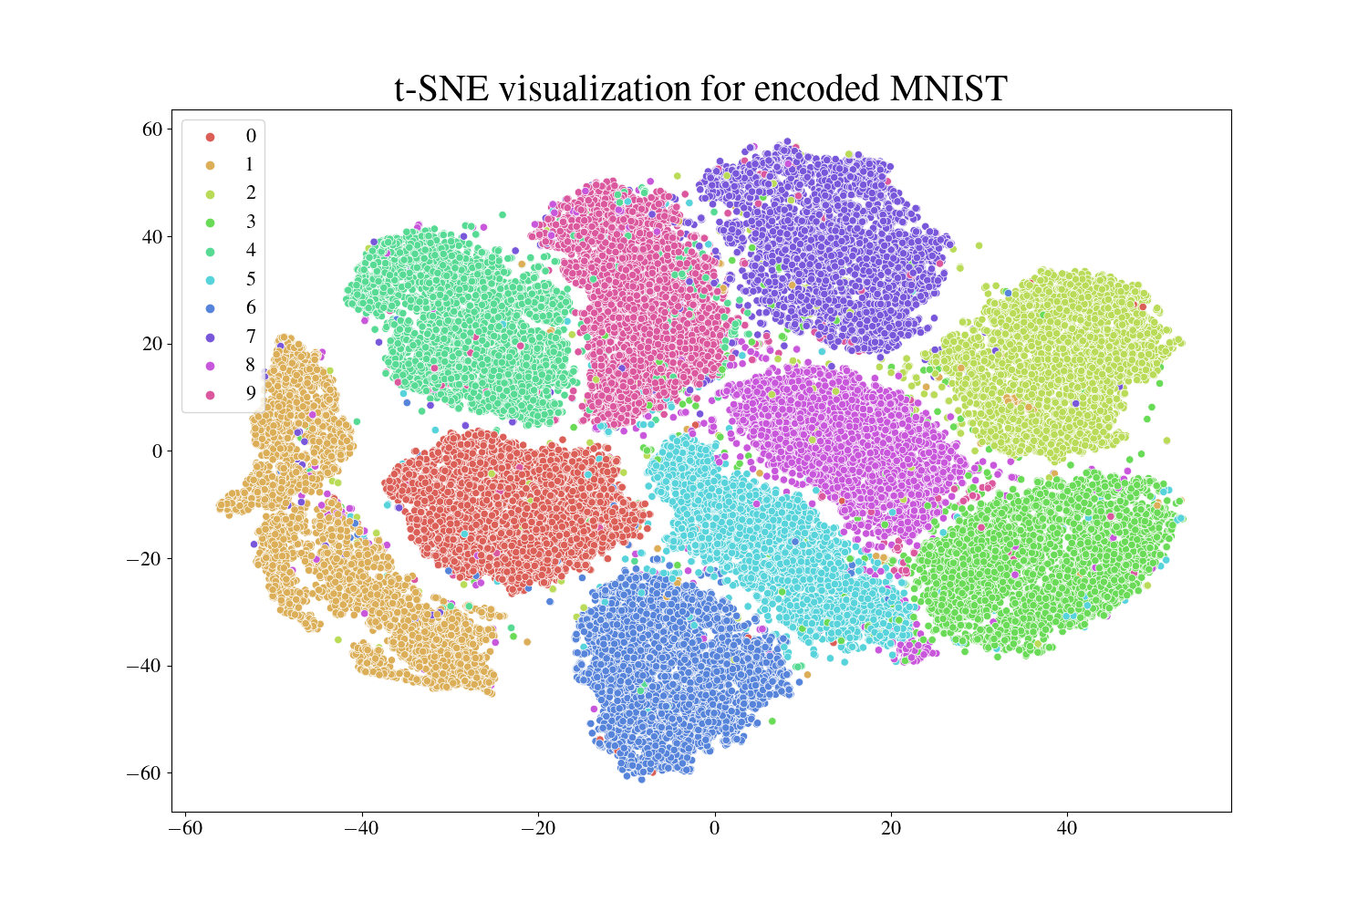
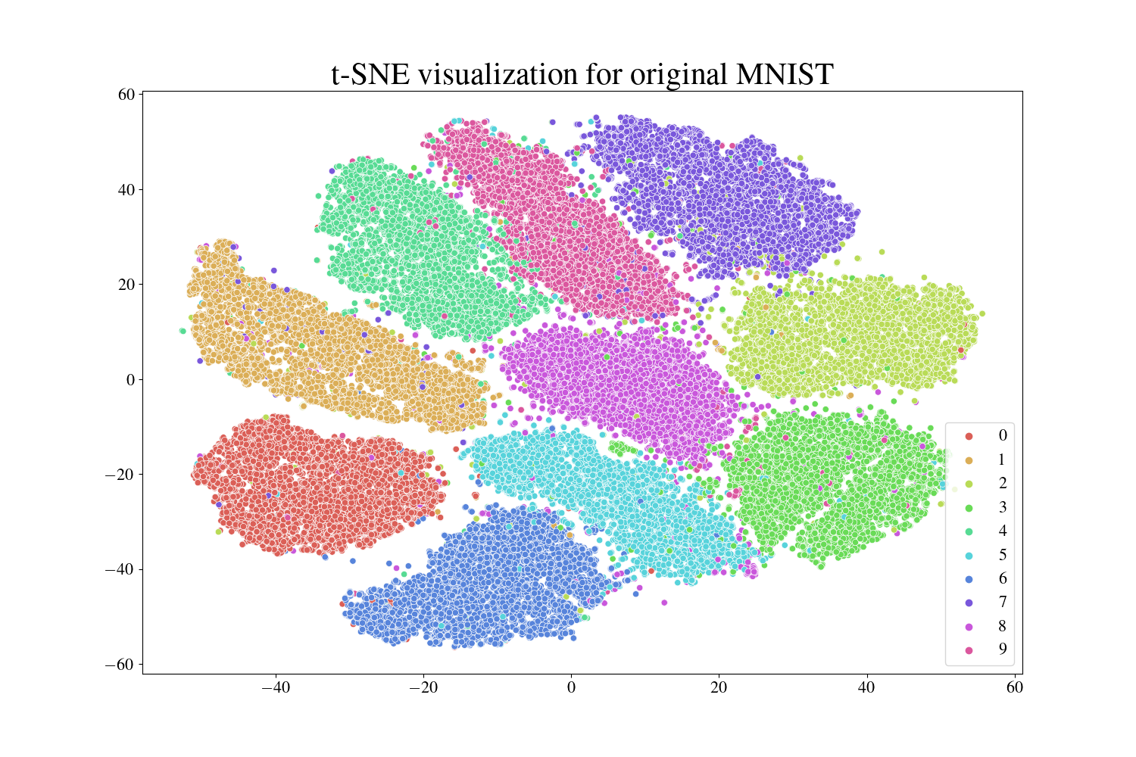

Slide 15
Figures

Slide 16



Brain Disorders
Cancer
Heart Conditions
Brain Disorders
Cancer
Heart Conditions
Alzheimer’s Disease
Parkinson’s Disease
Epilepsy
Kidney cancer
Ovarian cancer
Thyroid cancer
Coronary Artery Disease
Heart Failure

Slide 19

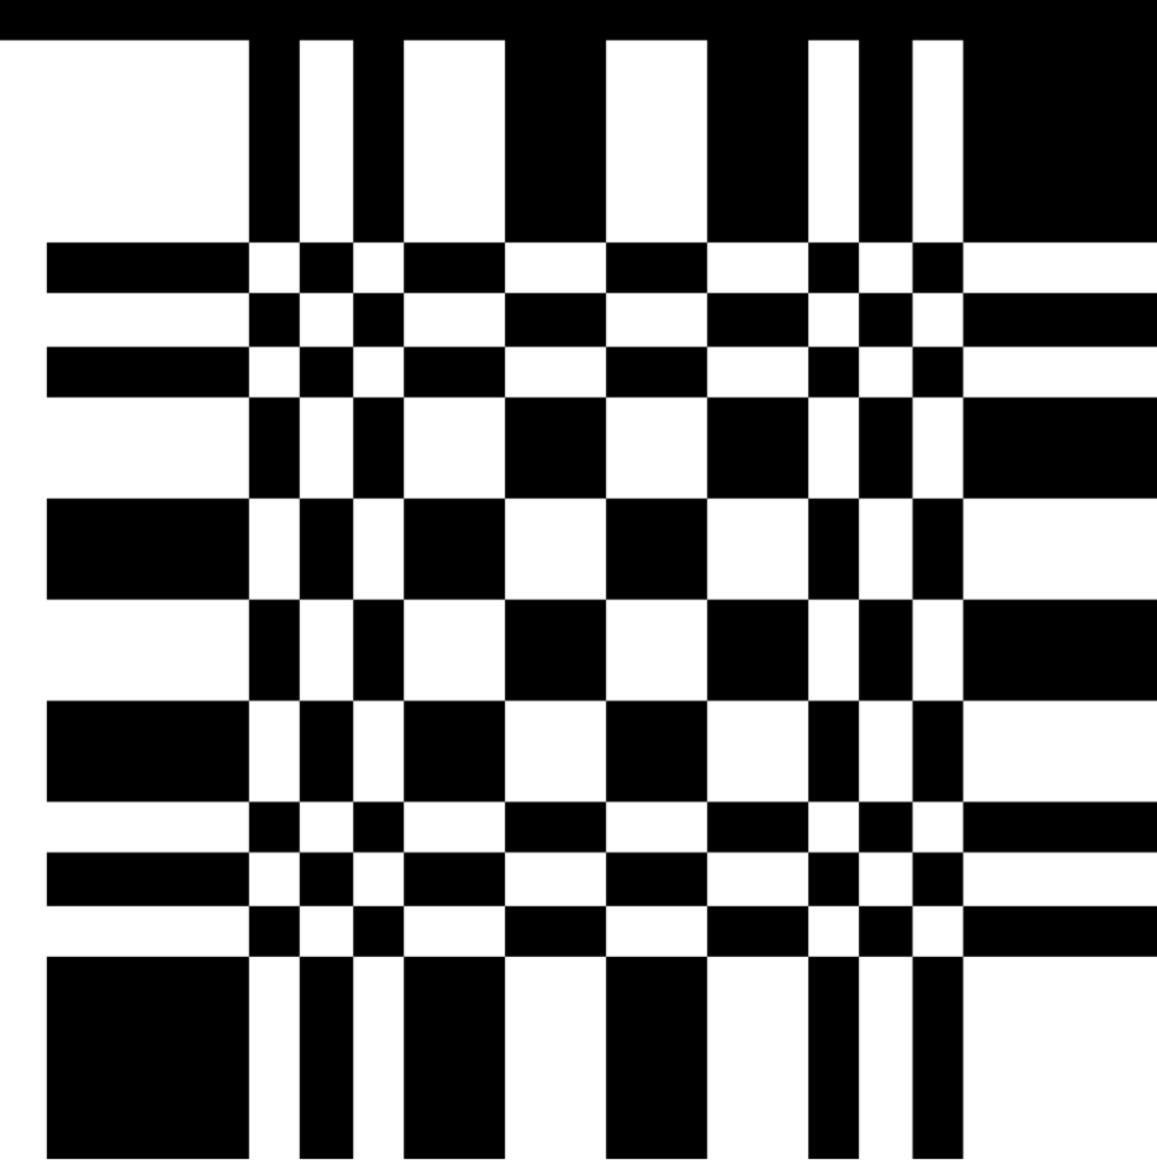
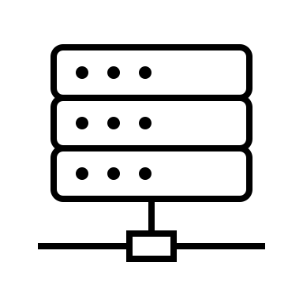

Xray pinhole camera (wip)
X-RAY SOURCE
DECODING PROCEDURE
RECONSTRUCTED IMAGE
X-RAYS
PATIENT
APERTURE
DETECTOR

Slide 20

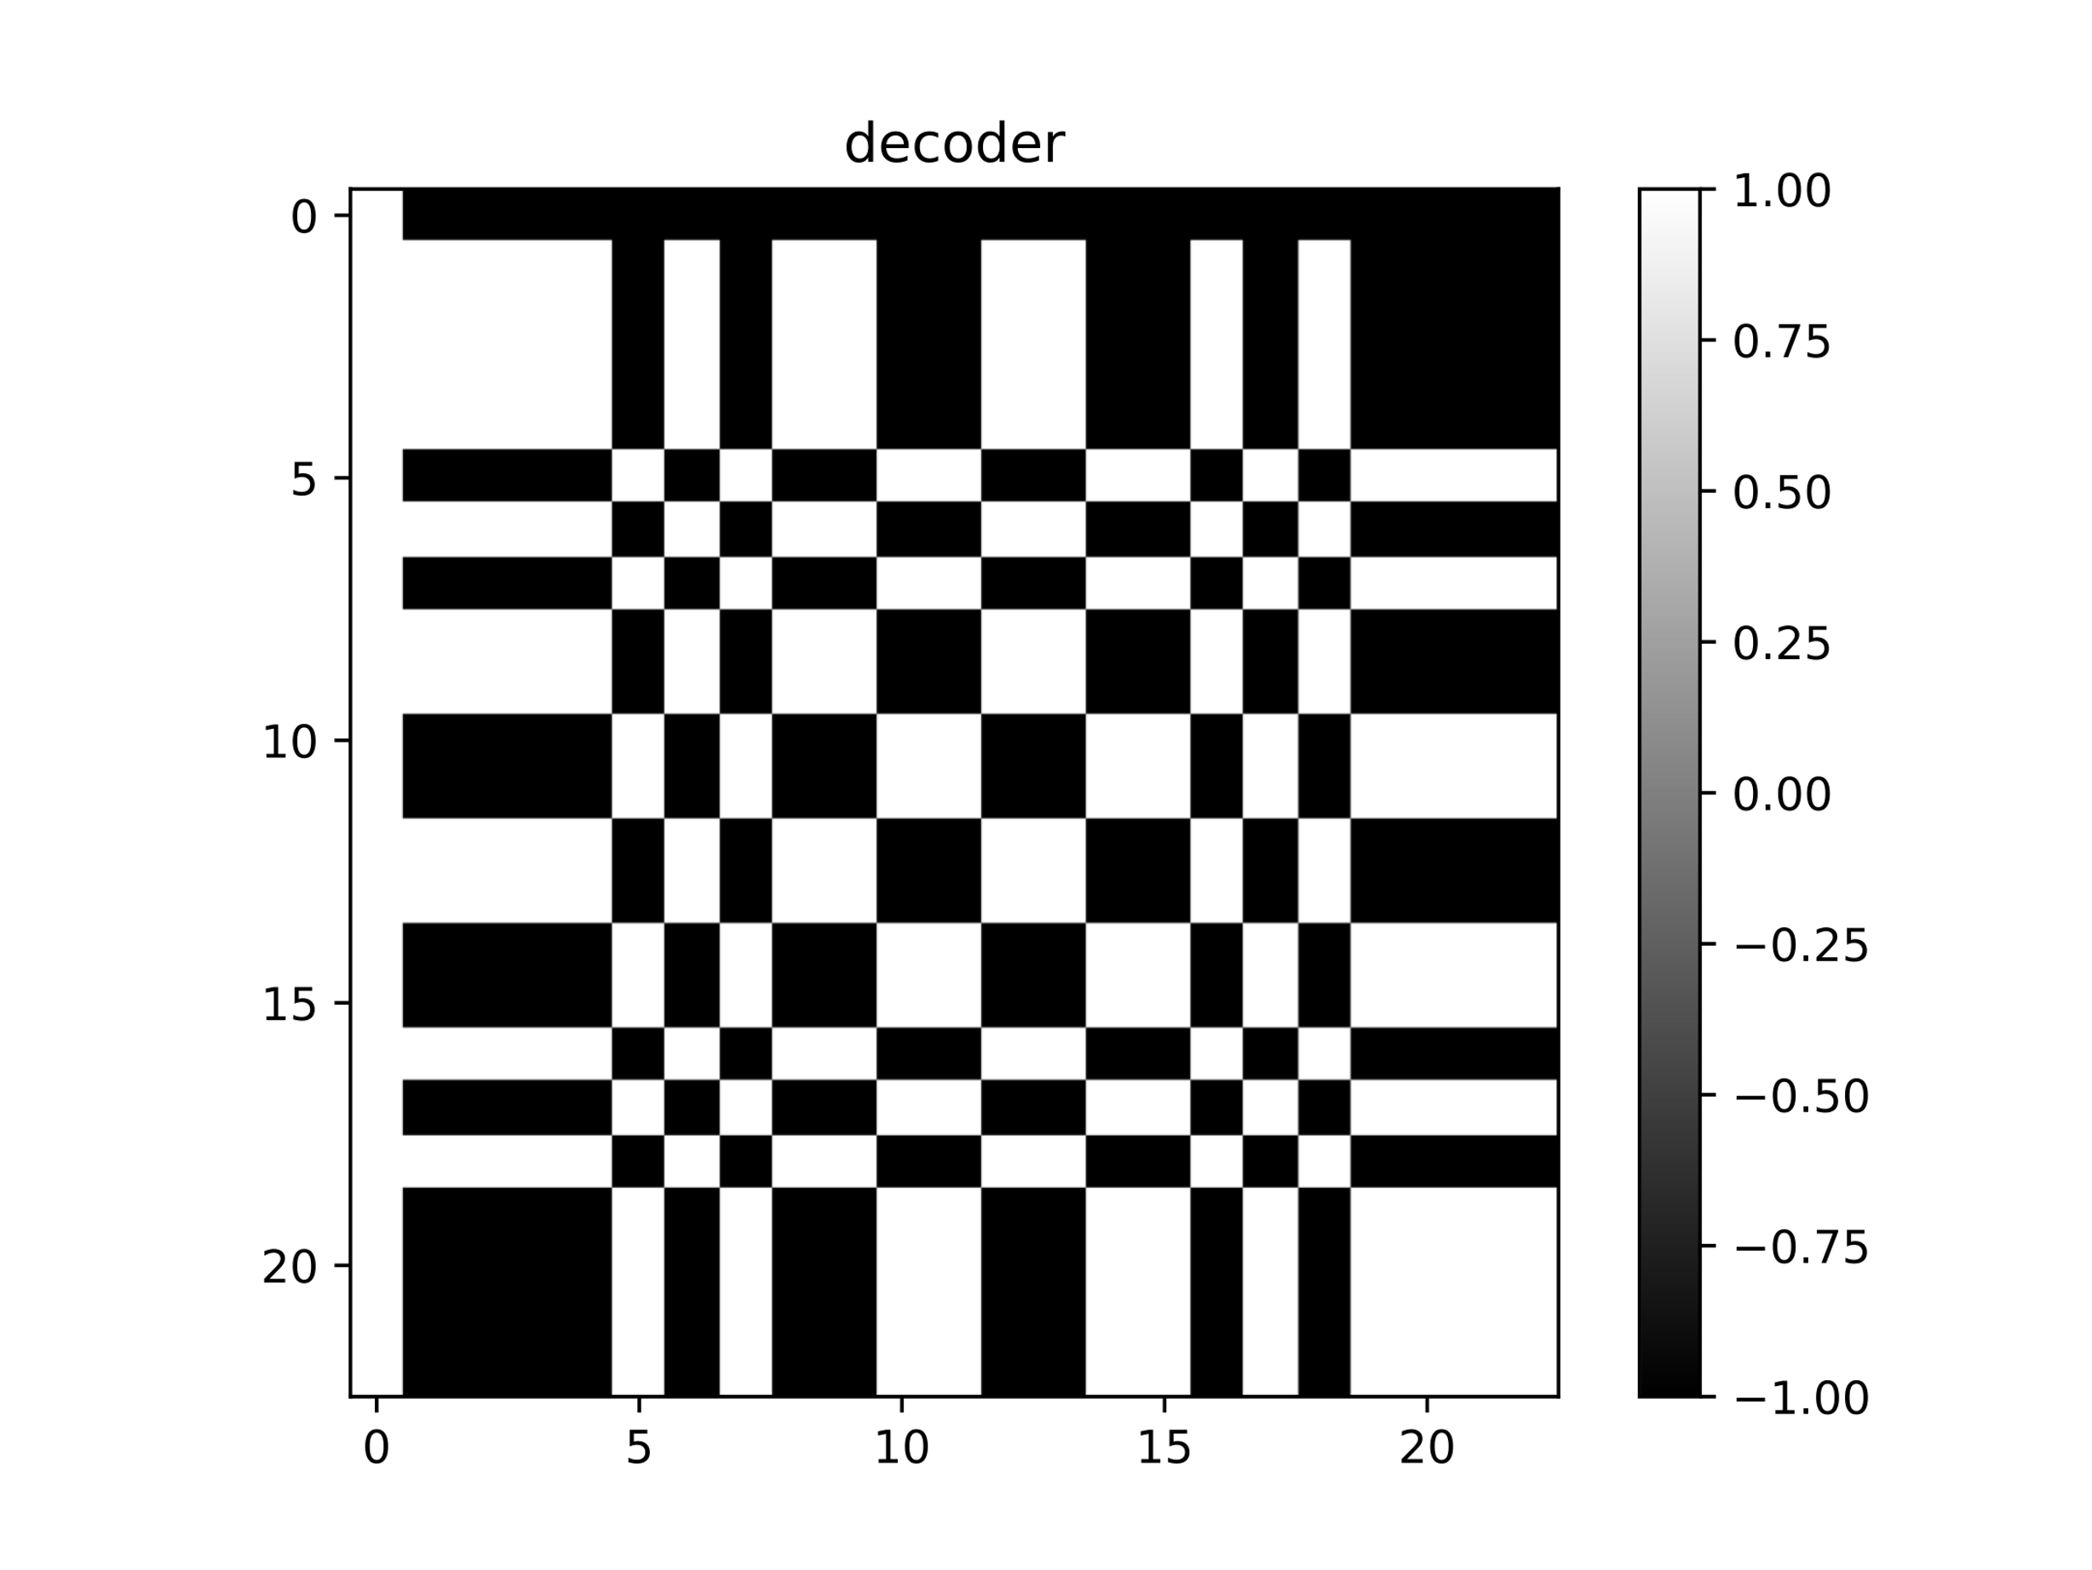
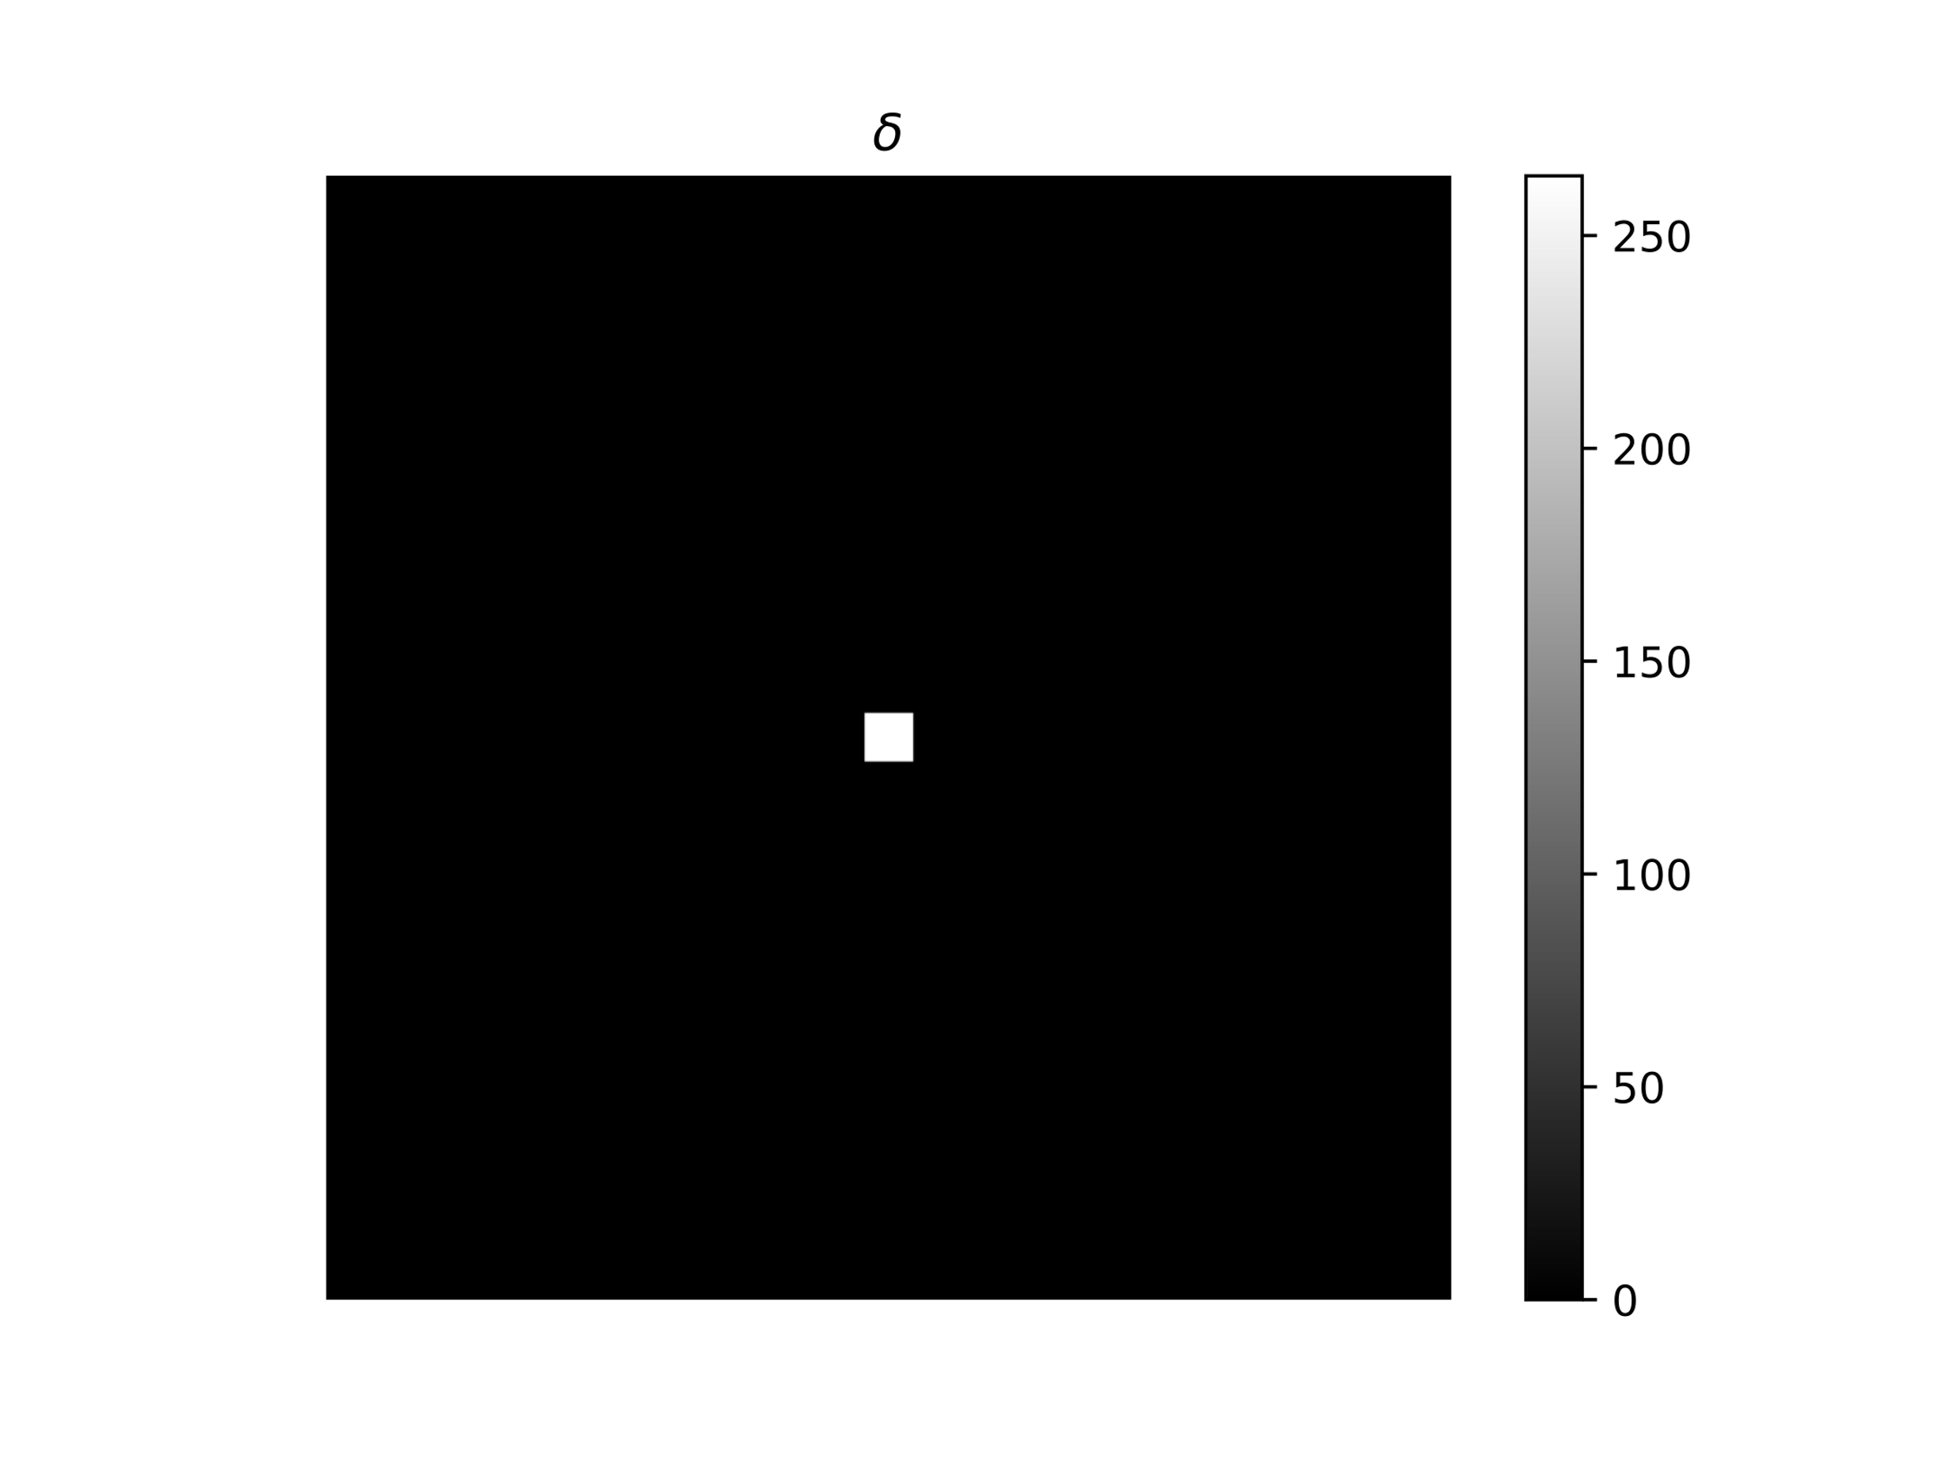
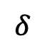
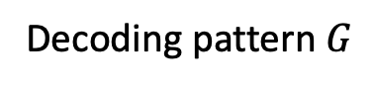

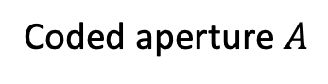

$$∗$$
$$=$$
Coded aperture $A$
Decoding pattern $G$
$$δ$$

Slide 21
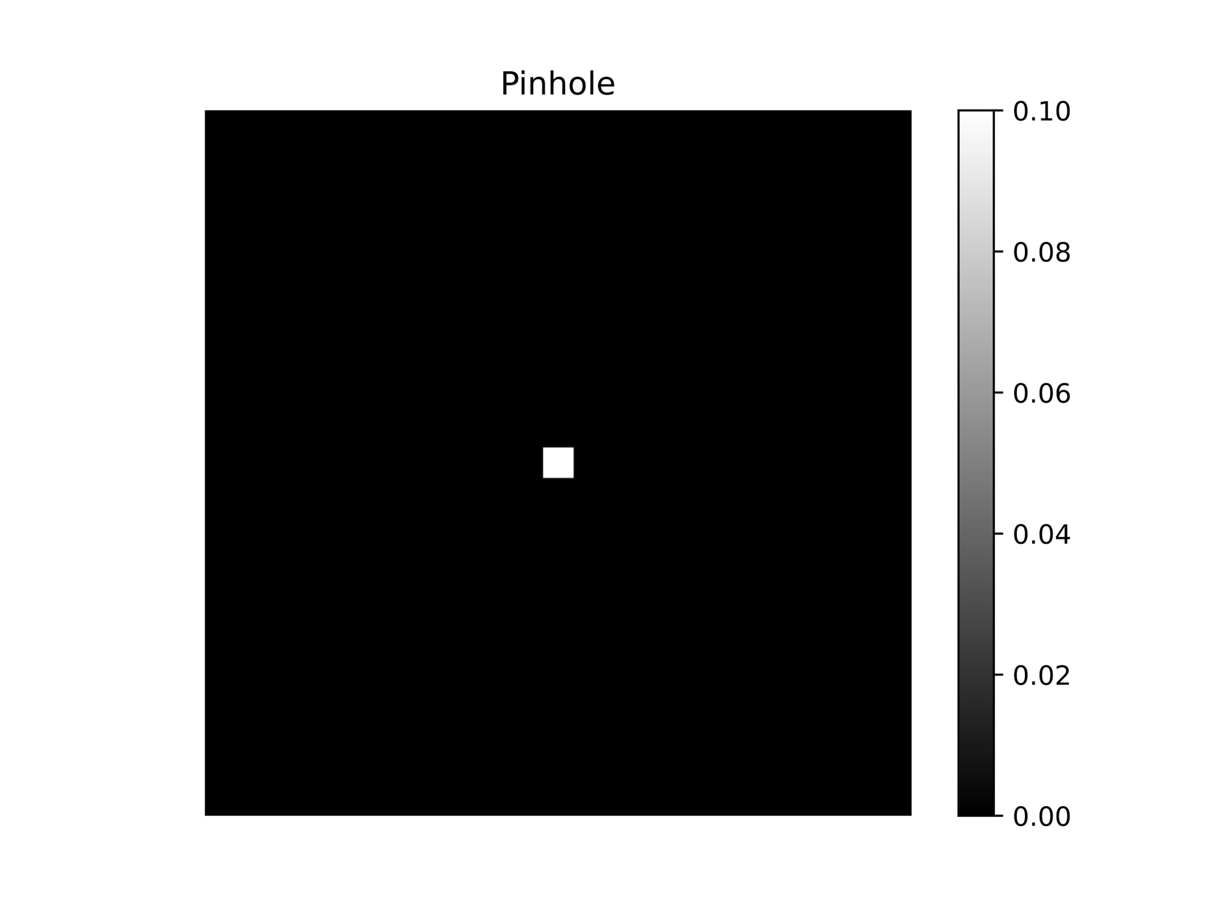
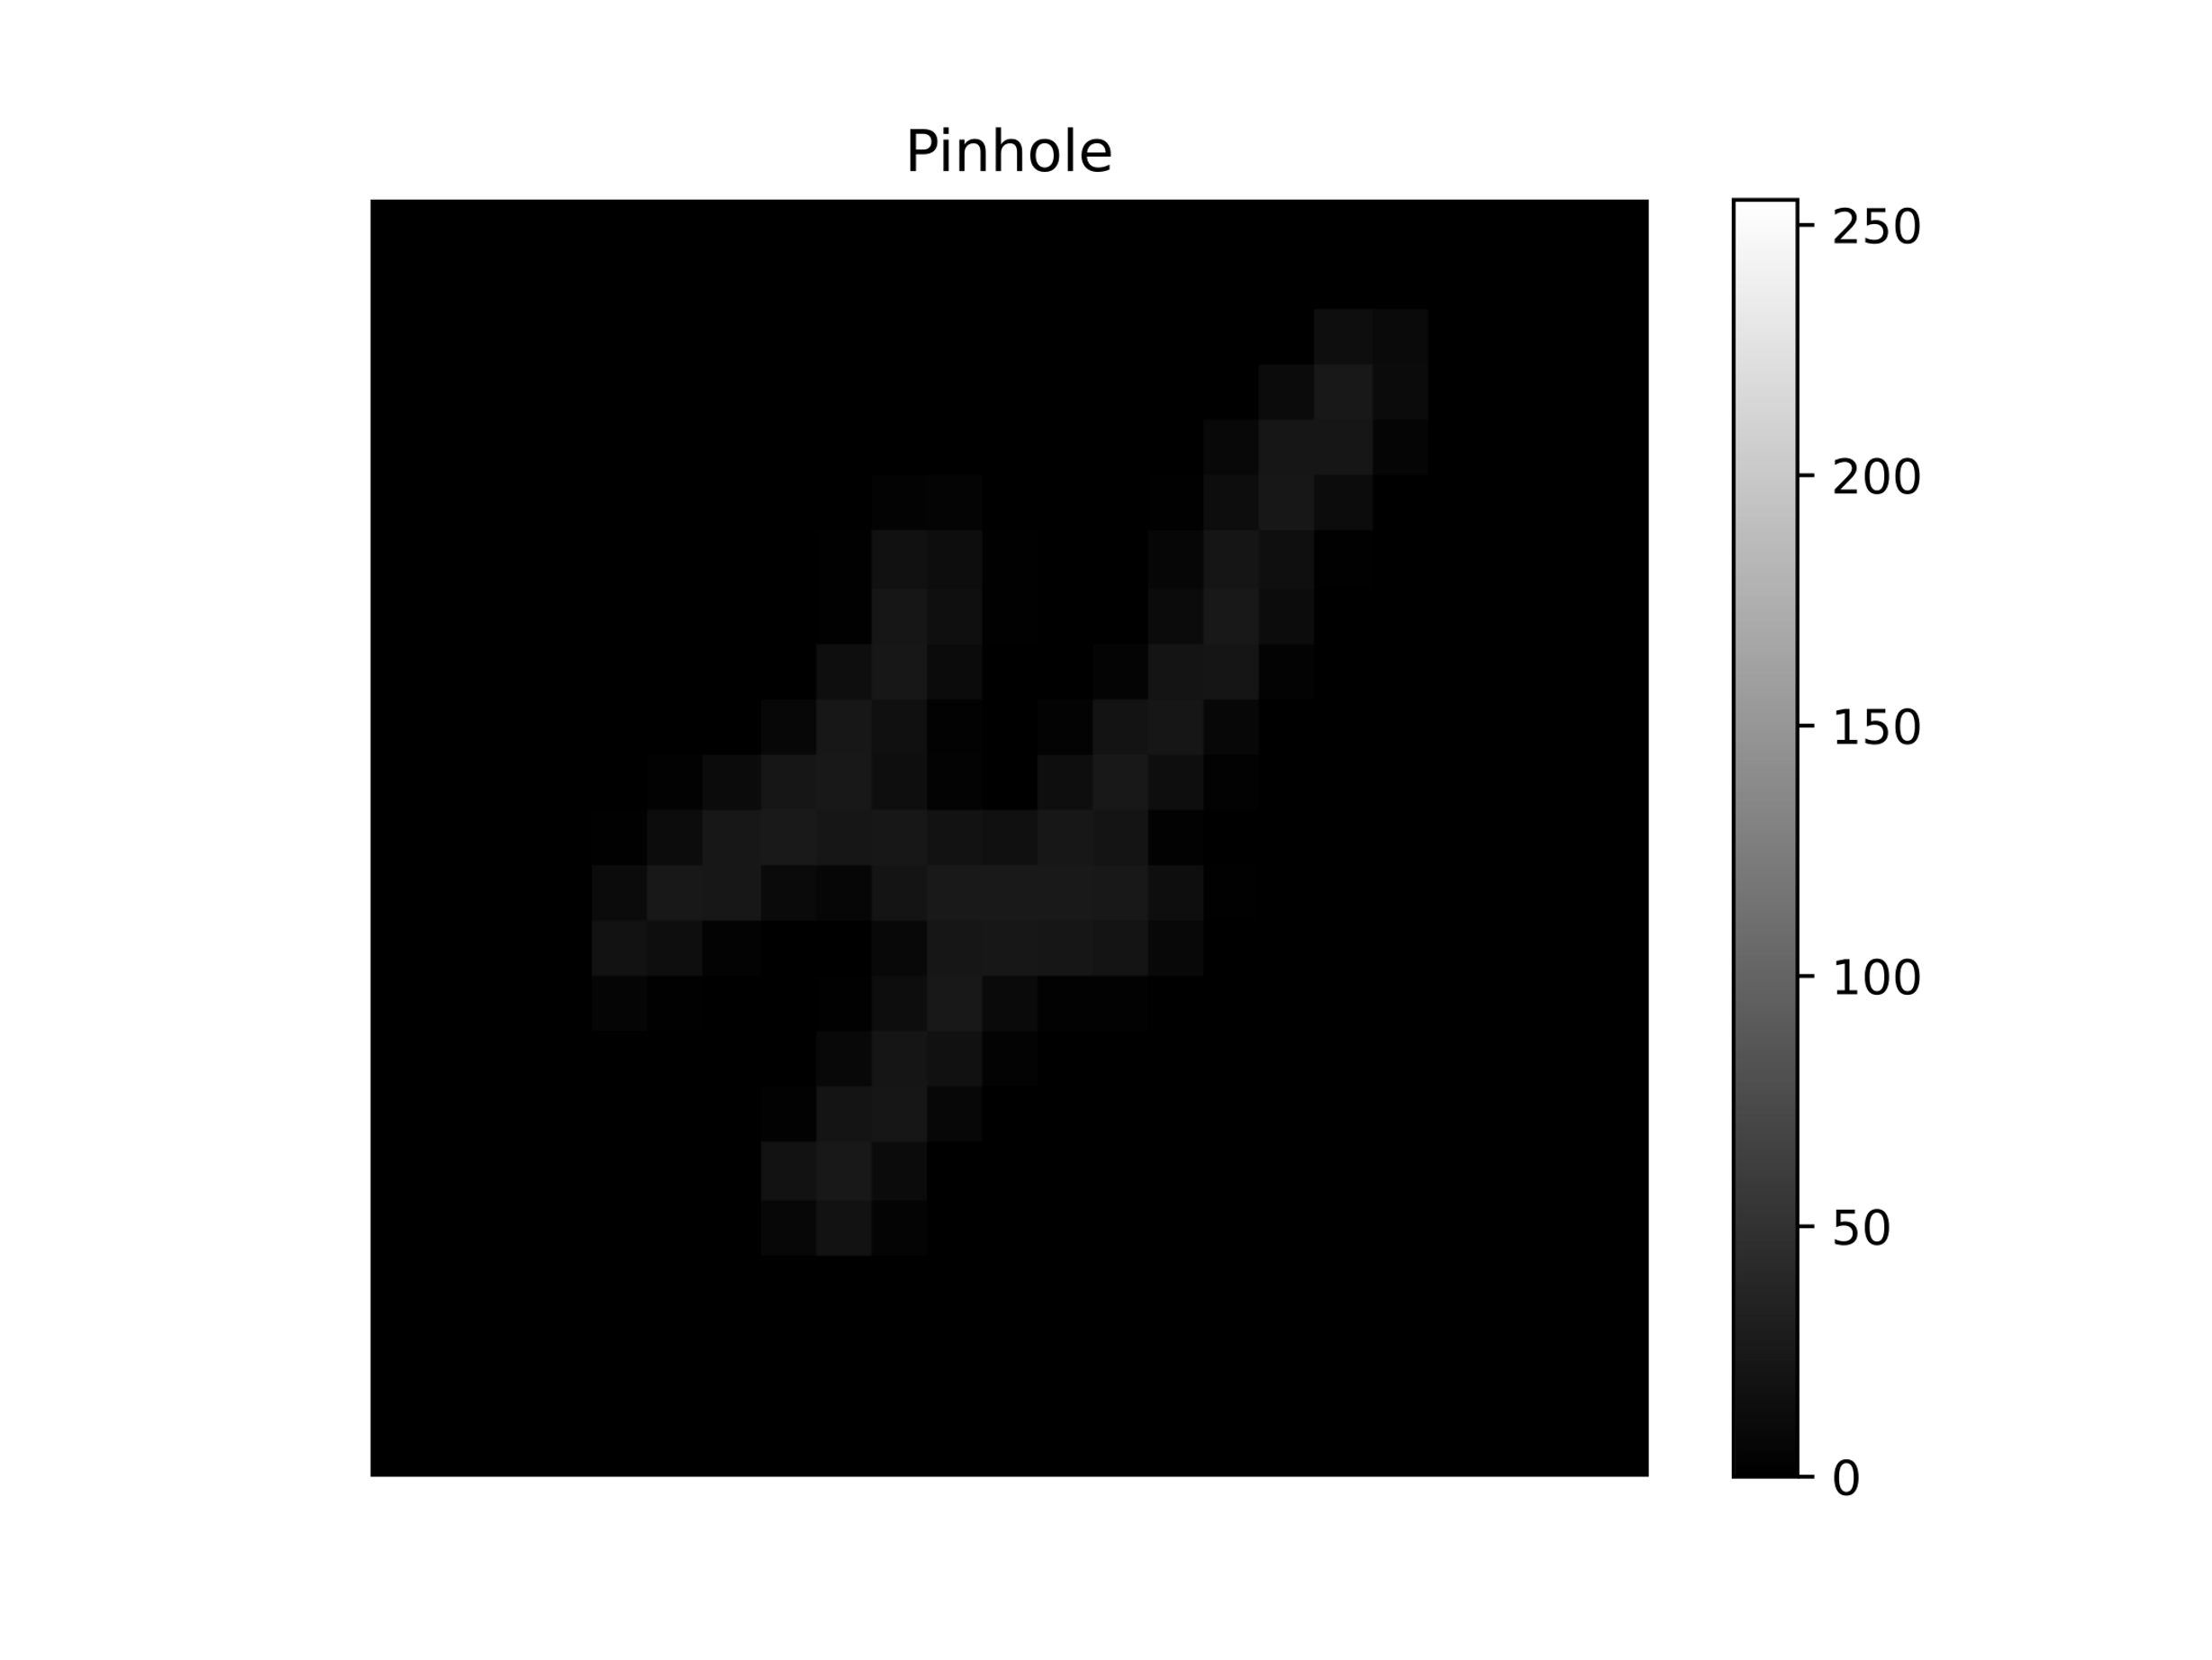
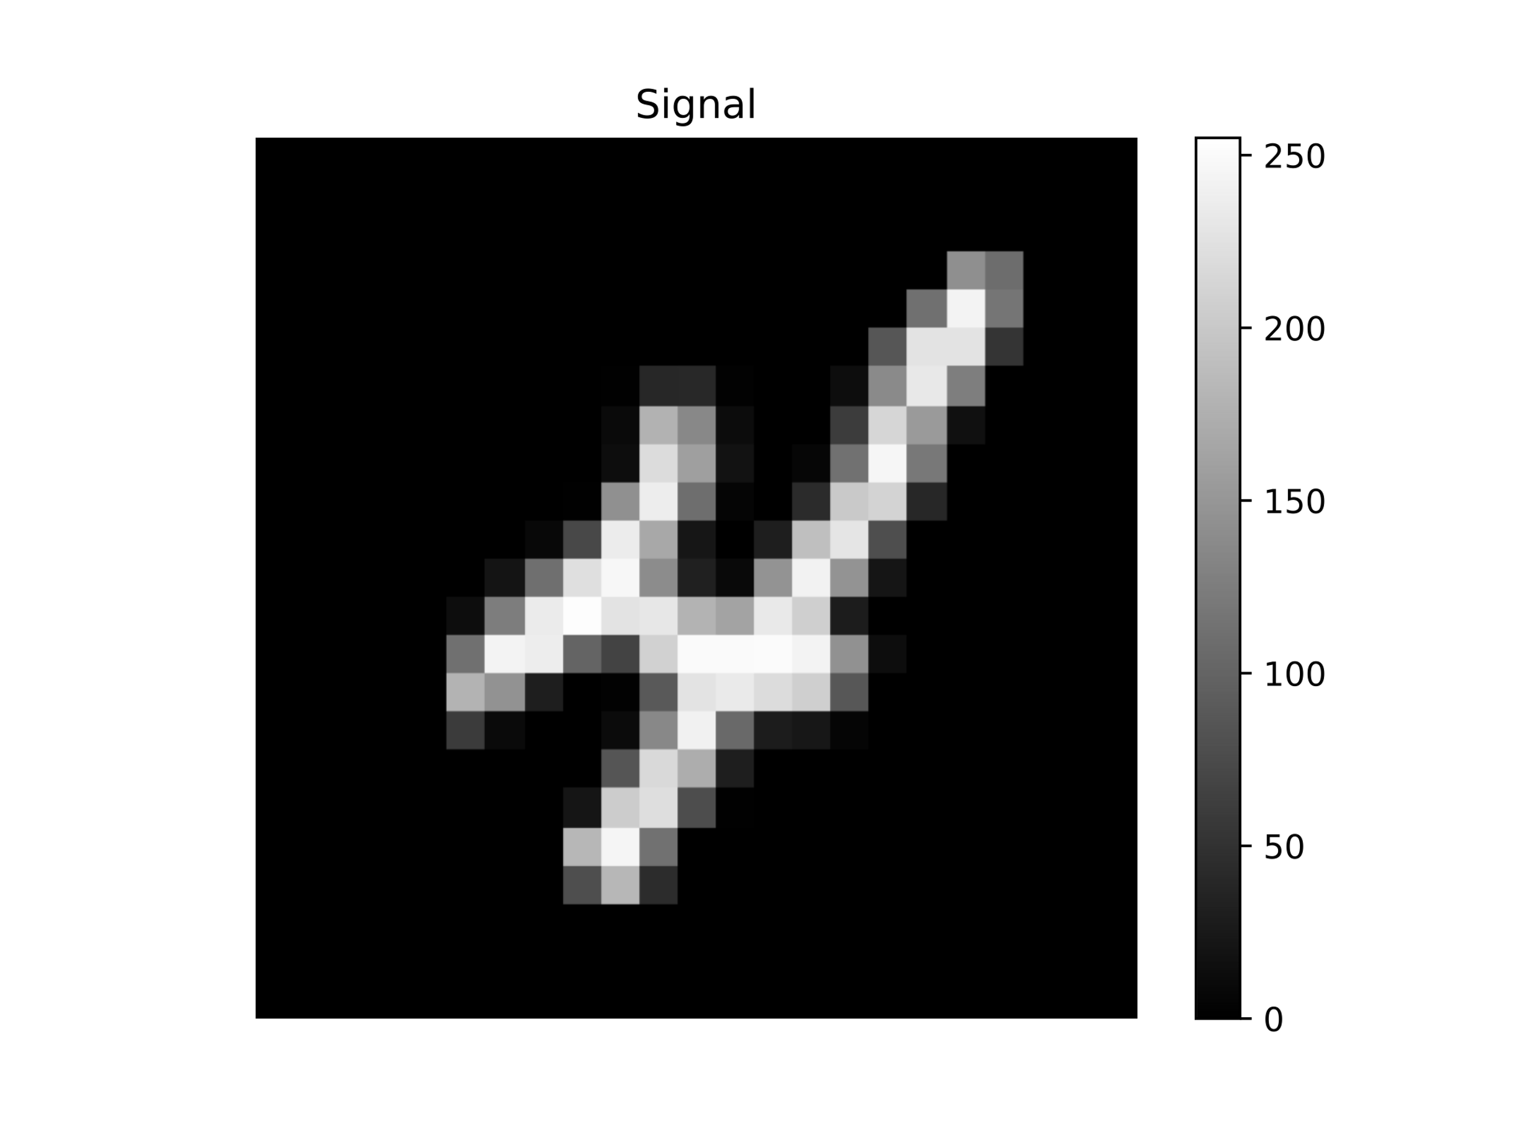
Aperture
Observation
Signal

Slide 22
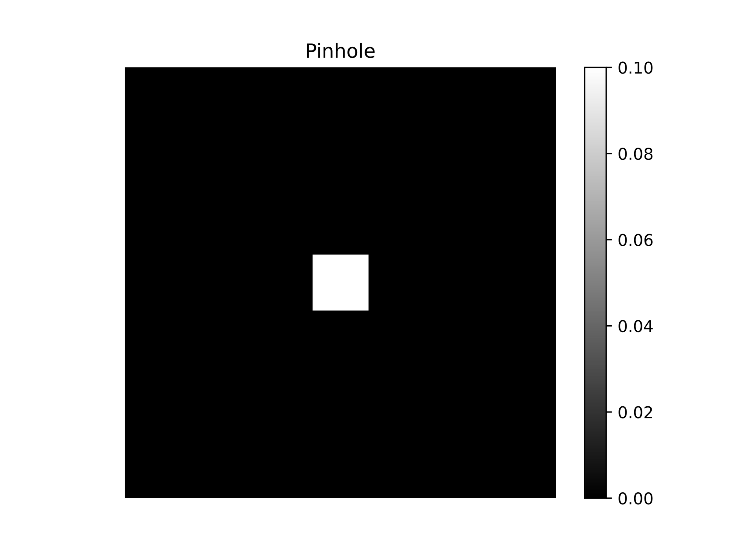
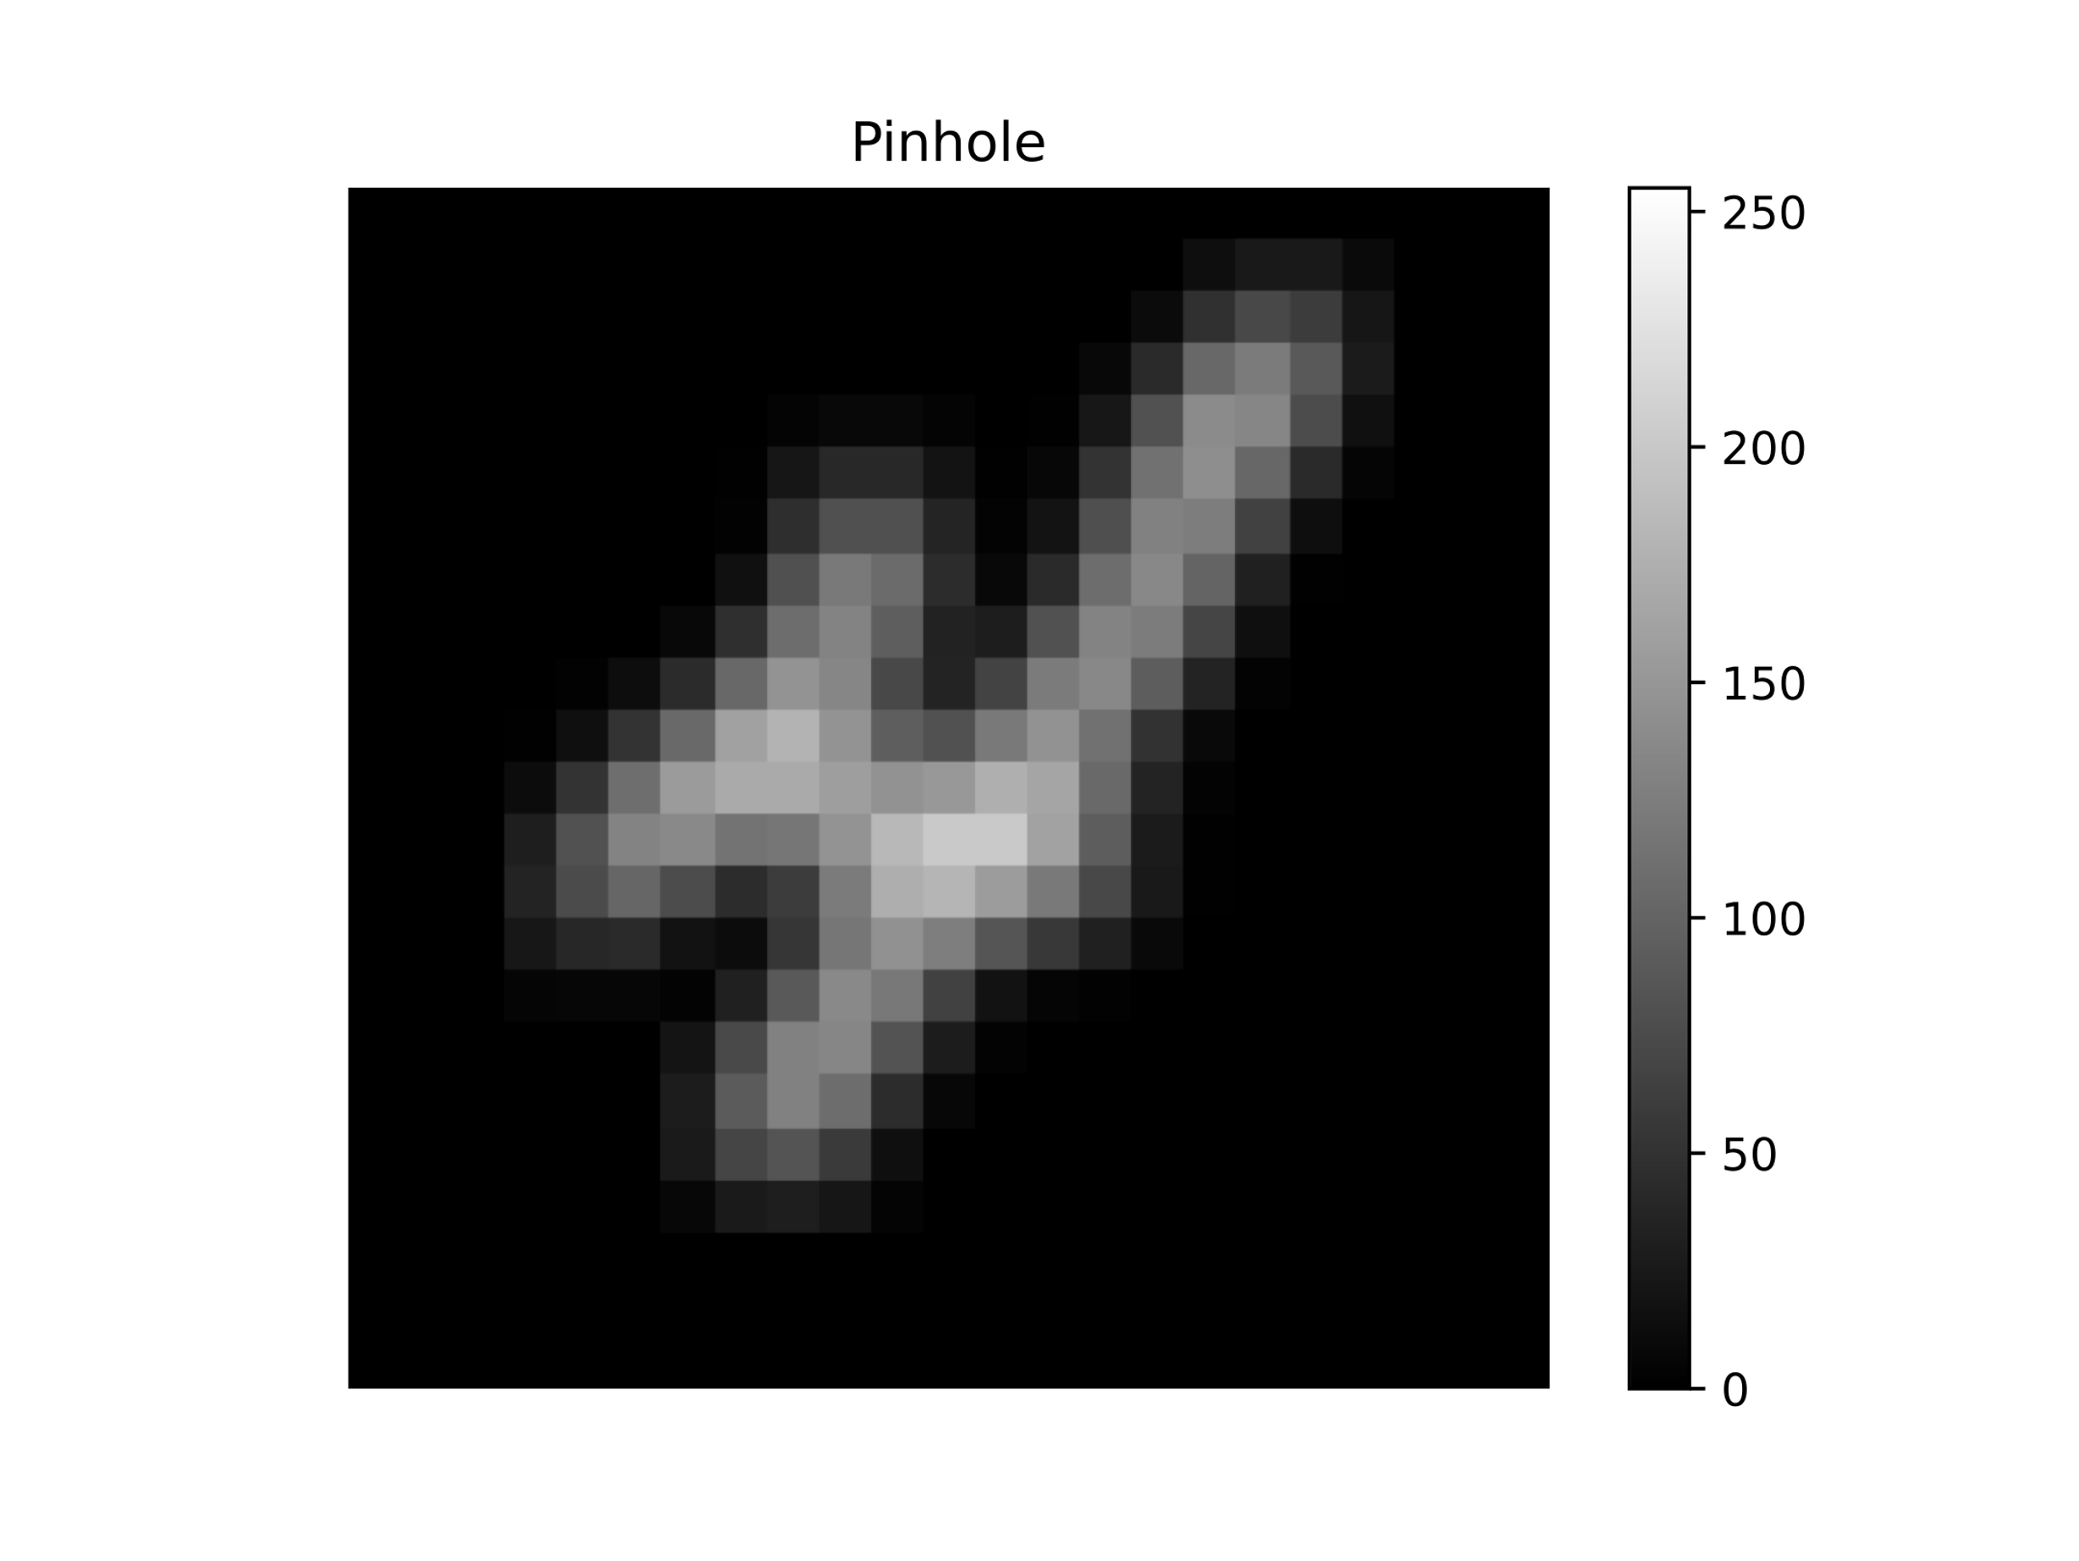
Aperture
Observation
Signal

Slide 23

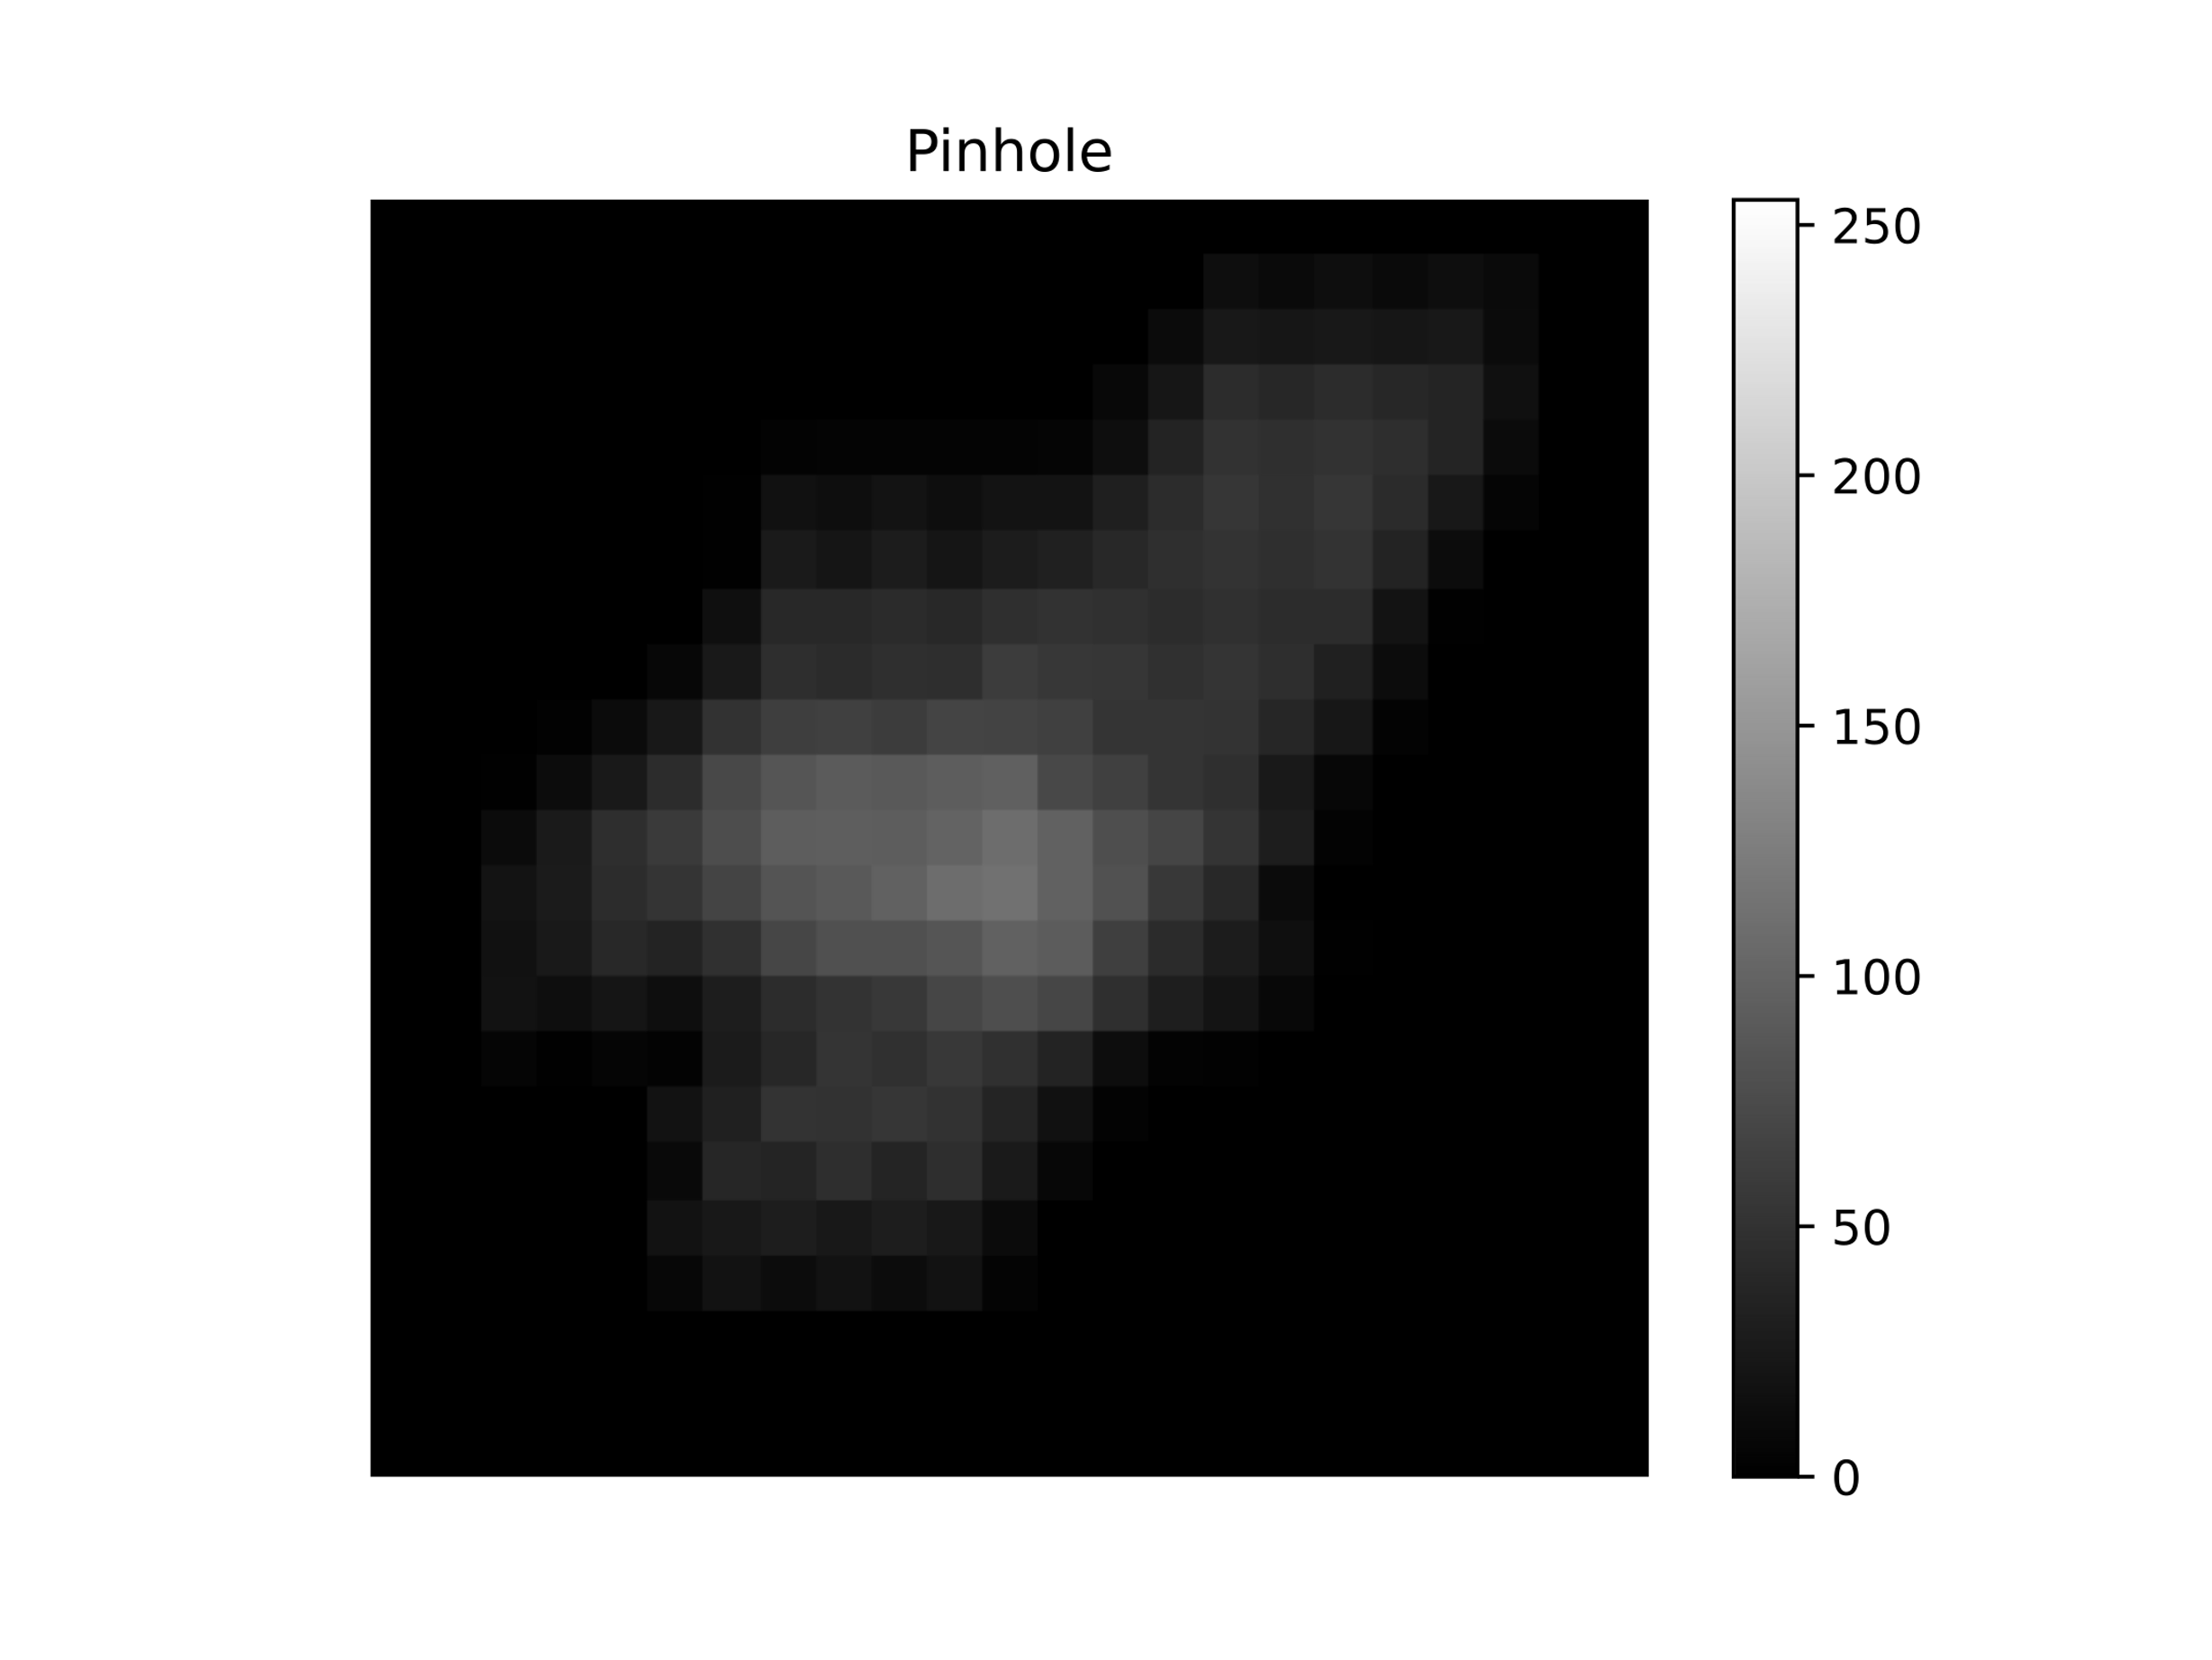
Aperture
Observation
Signal

Slide 24



$$∗$$
$$∗$$
$$=$$

Slide 25
$$∗$$
$$∗$$
$$=$$
Coded observation

Slide 26




Signal
Aperture
Observation
Reconstruction
$$S$$
$$A$$
$$D$$
$$\hat{S}$$

Slide 27
2
X-RAY SOURCE
X-RAYS
SOURCE
APERTURE
OBSERVATION
DECODING PROCEDURE
CLASSIFICATION

Slide 28
conv
2
convolutional + sigmoid
1 x 23 x 23

Slide 29
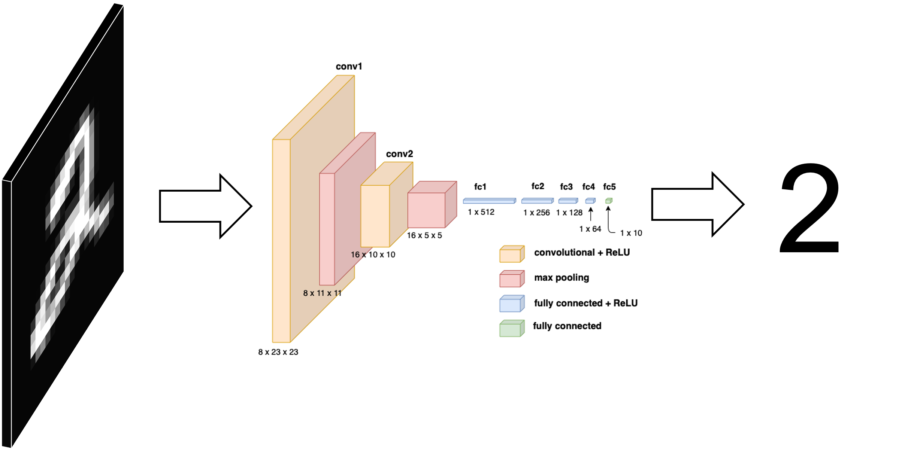
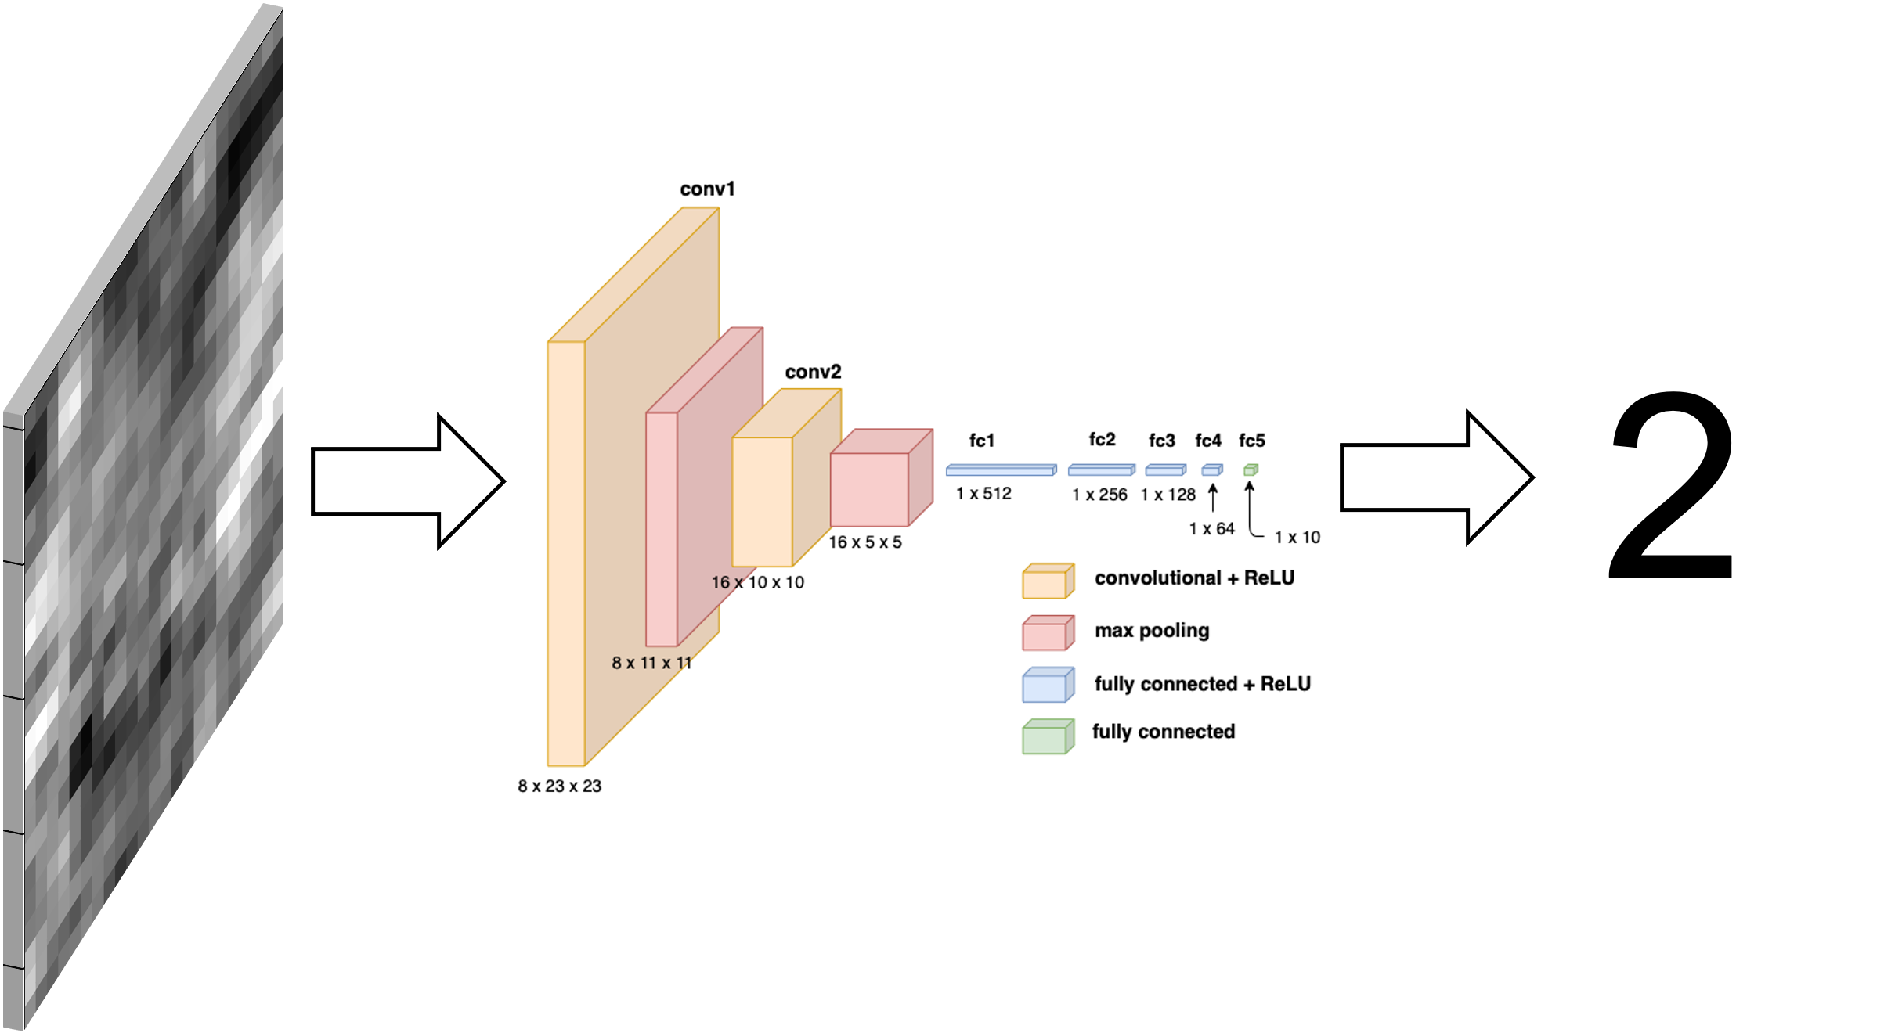

Slide 30
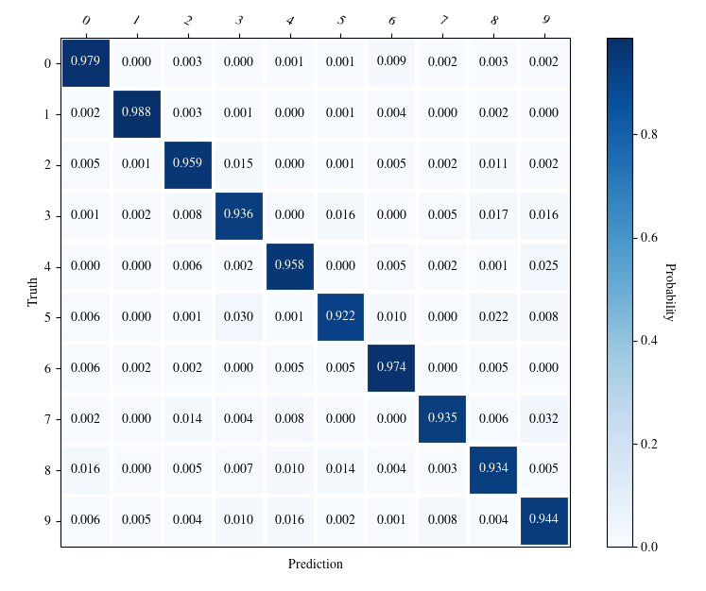

Slide 31
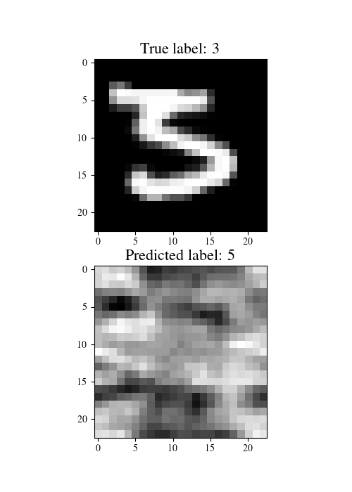
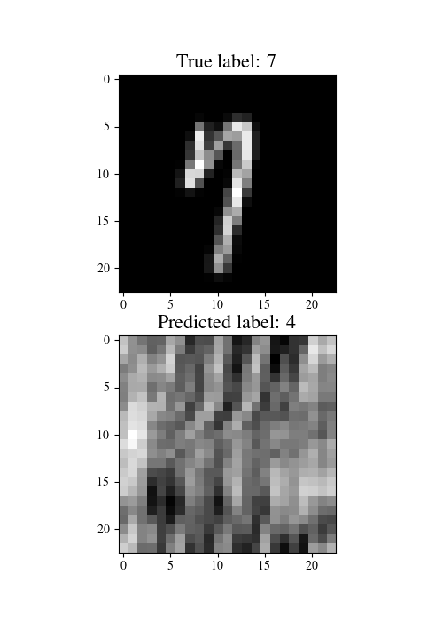
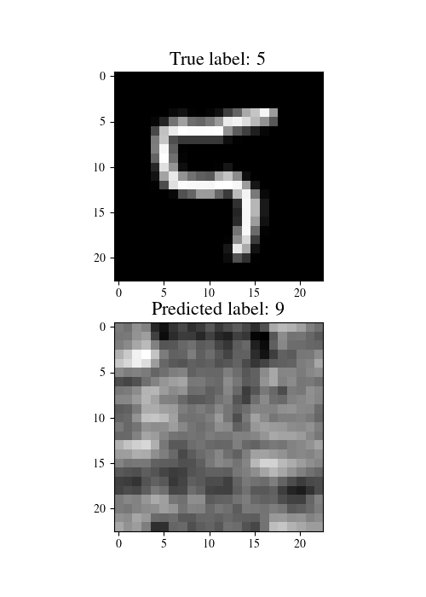
True image
Observation

Slide 32
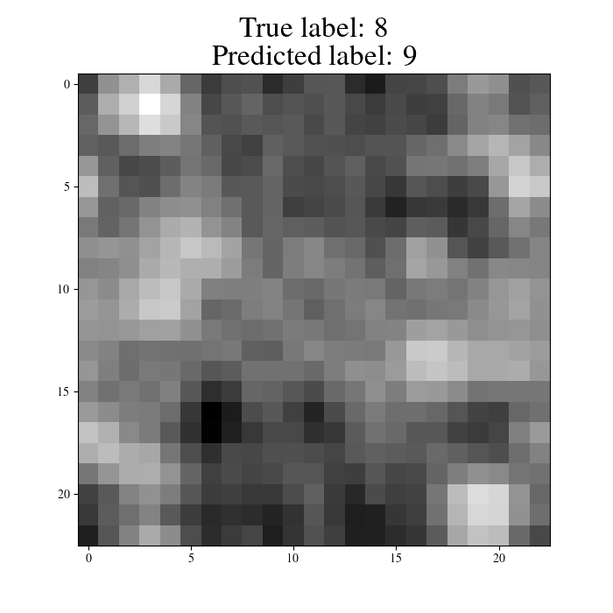
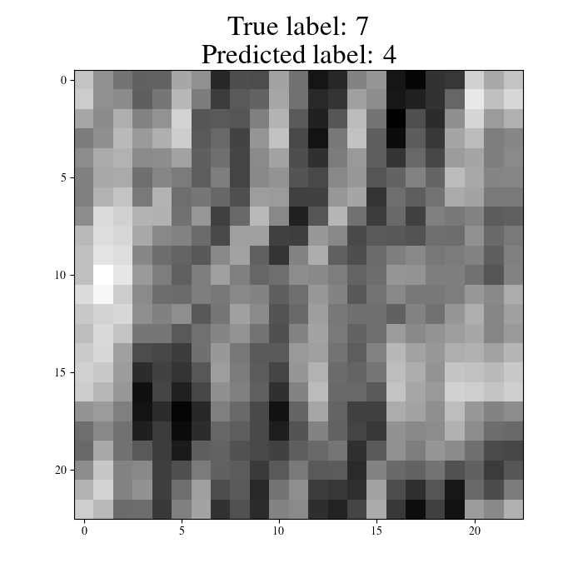
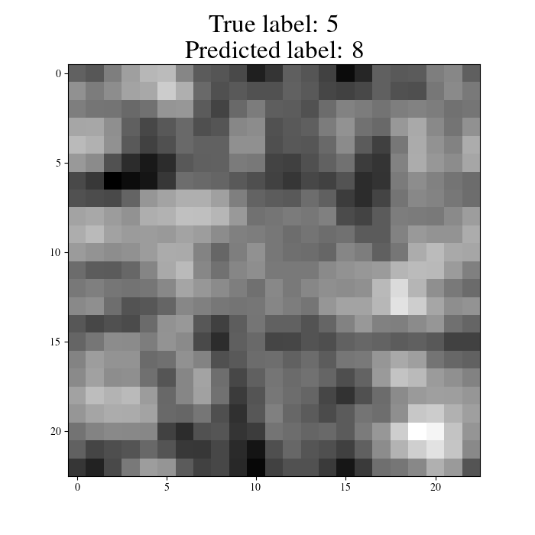
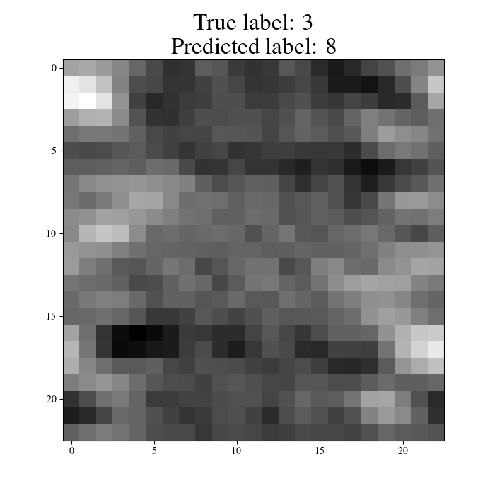
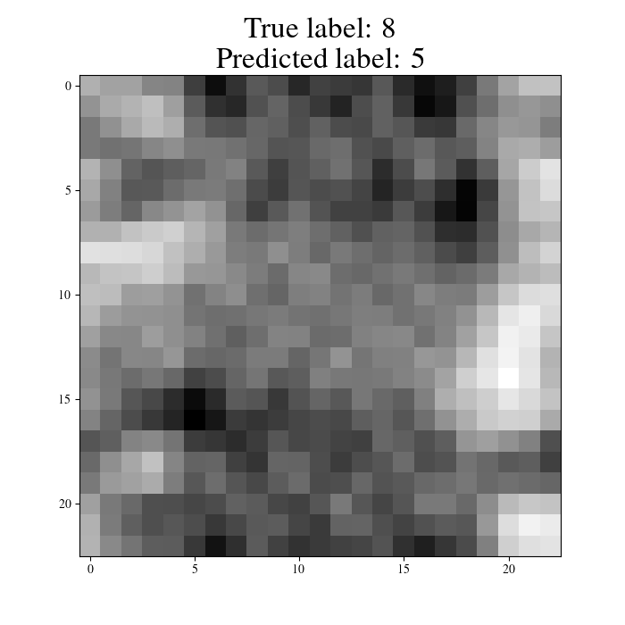
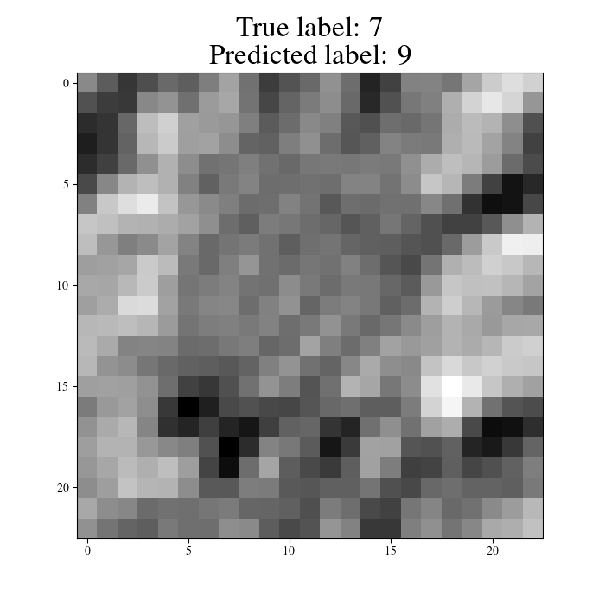
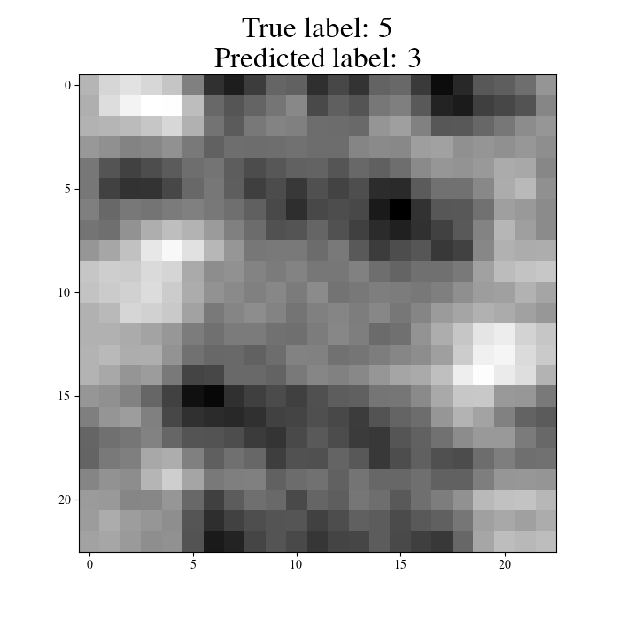
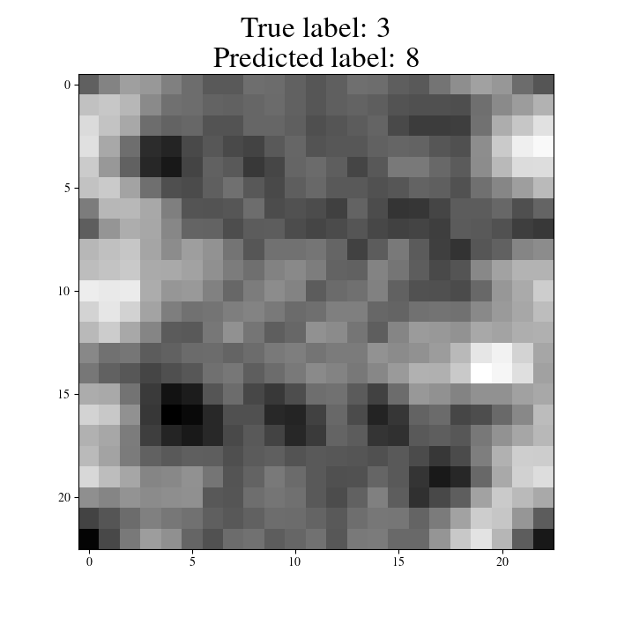

Slide 33
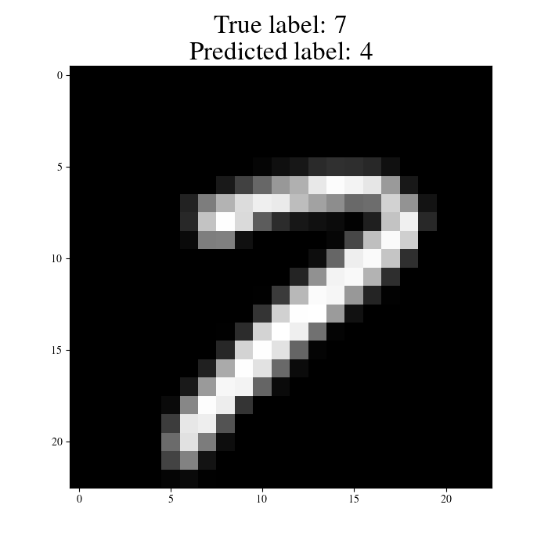
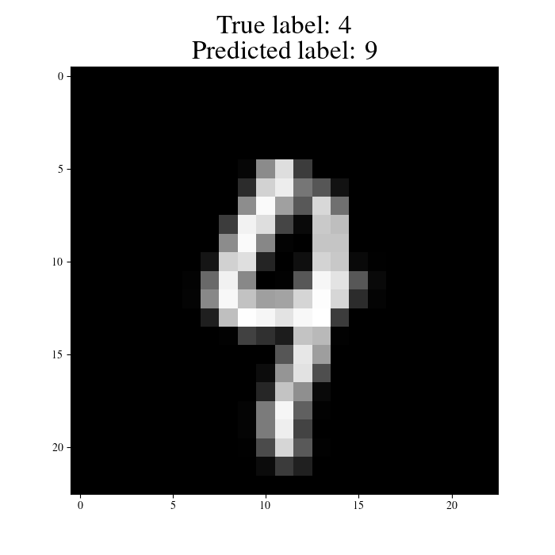
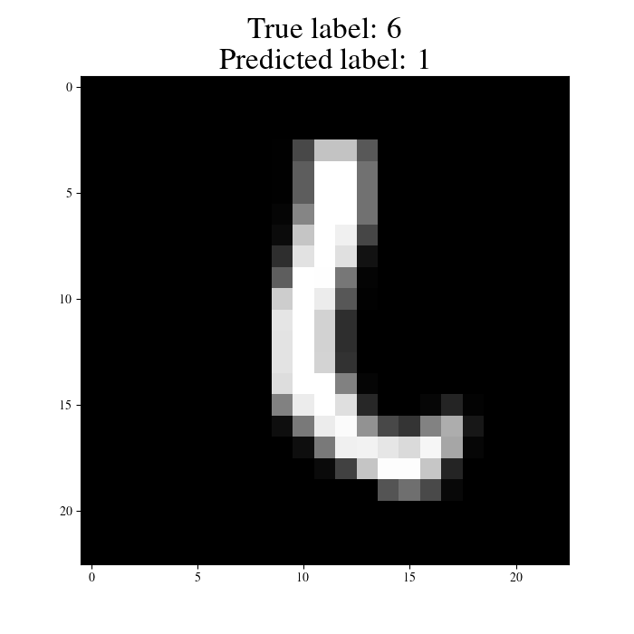
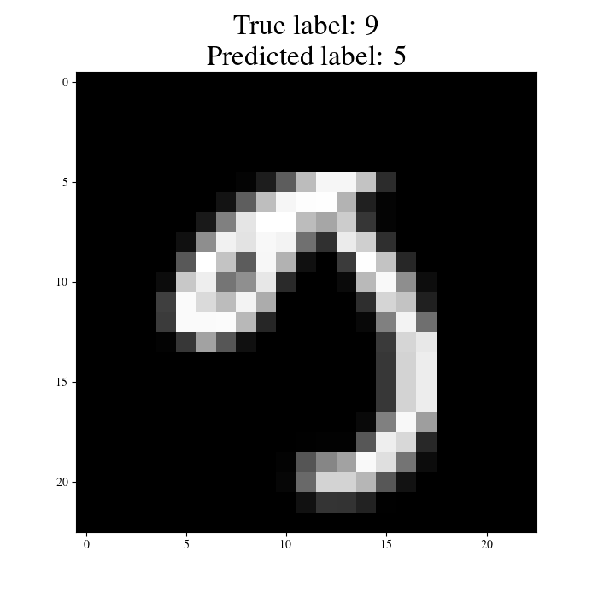
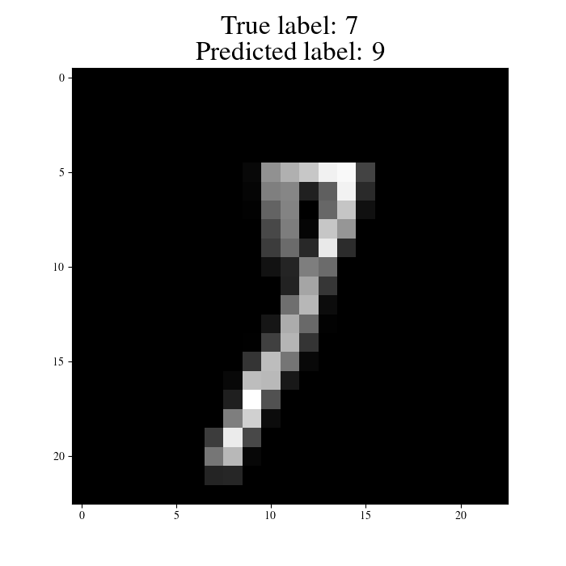
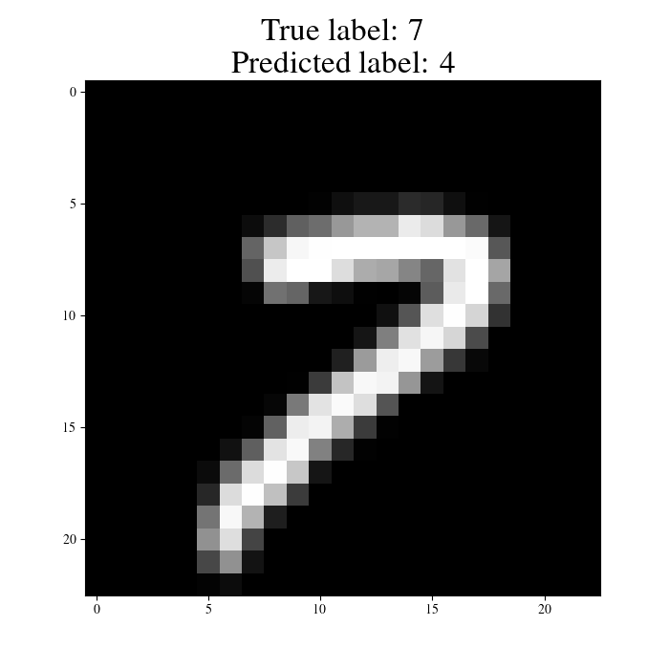
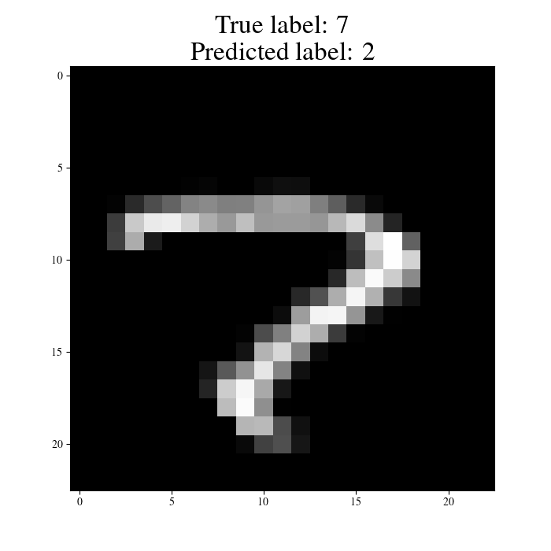
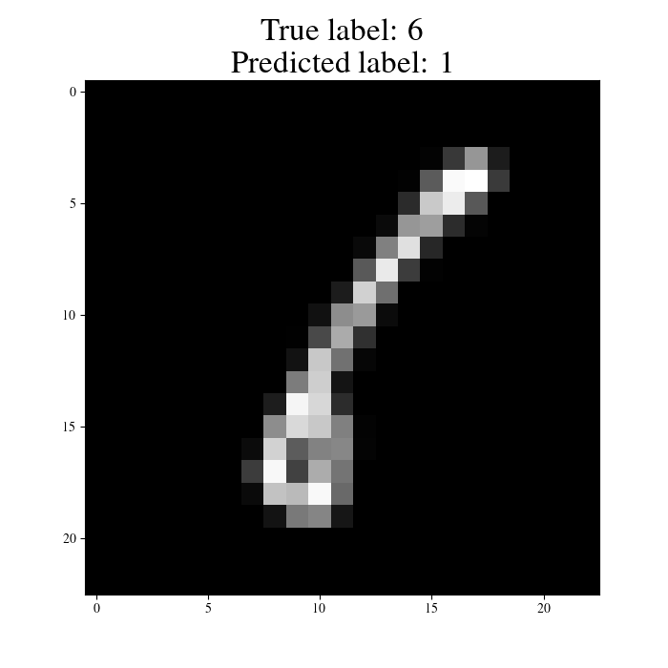
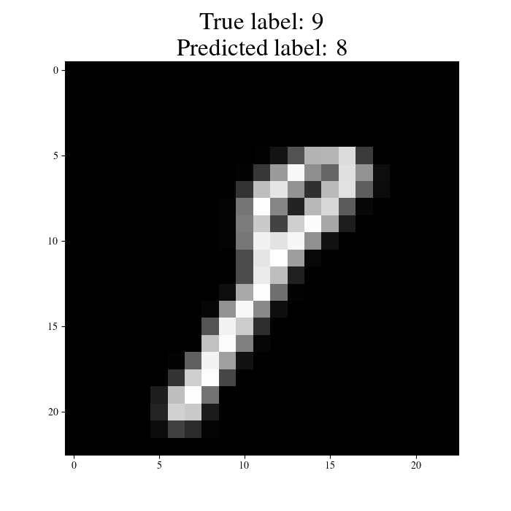
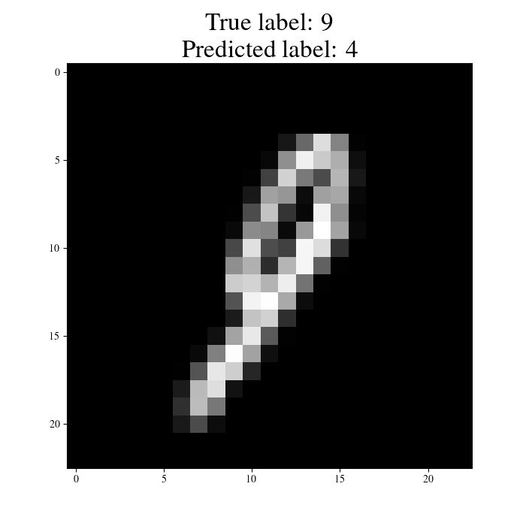

Misclassifications from original MNIST

